Slide 1








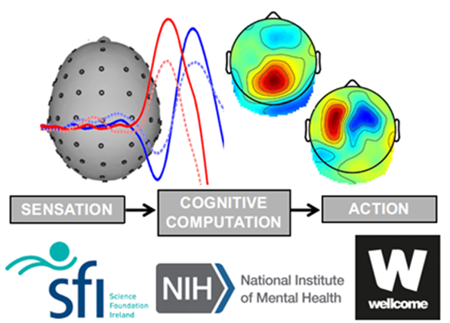


The influence of response effector on decision adaptations
Last time: 23/04/2024
04/11/2024
Lab meeting- Nov 2024
School of Electrical and Electronic Engineering
University College Dublin,
Biomedical Engineering, Dublin, Ireland,
liang.tong2@ucdconnect.ie
Liang Tong
17208987

Slide 2
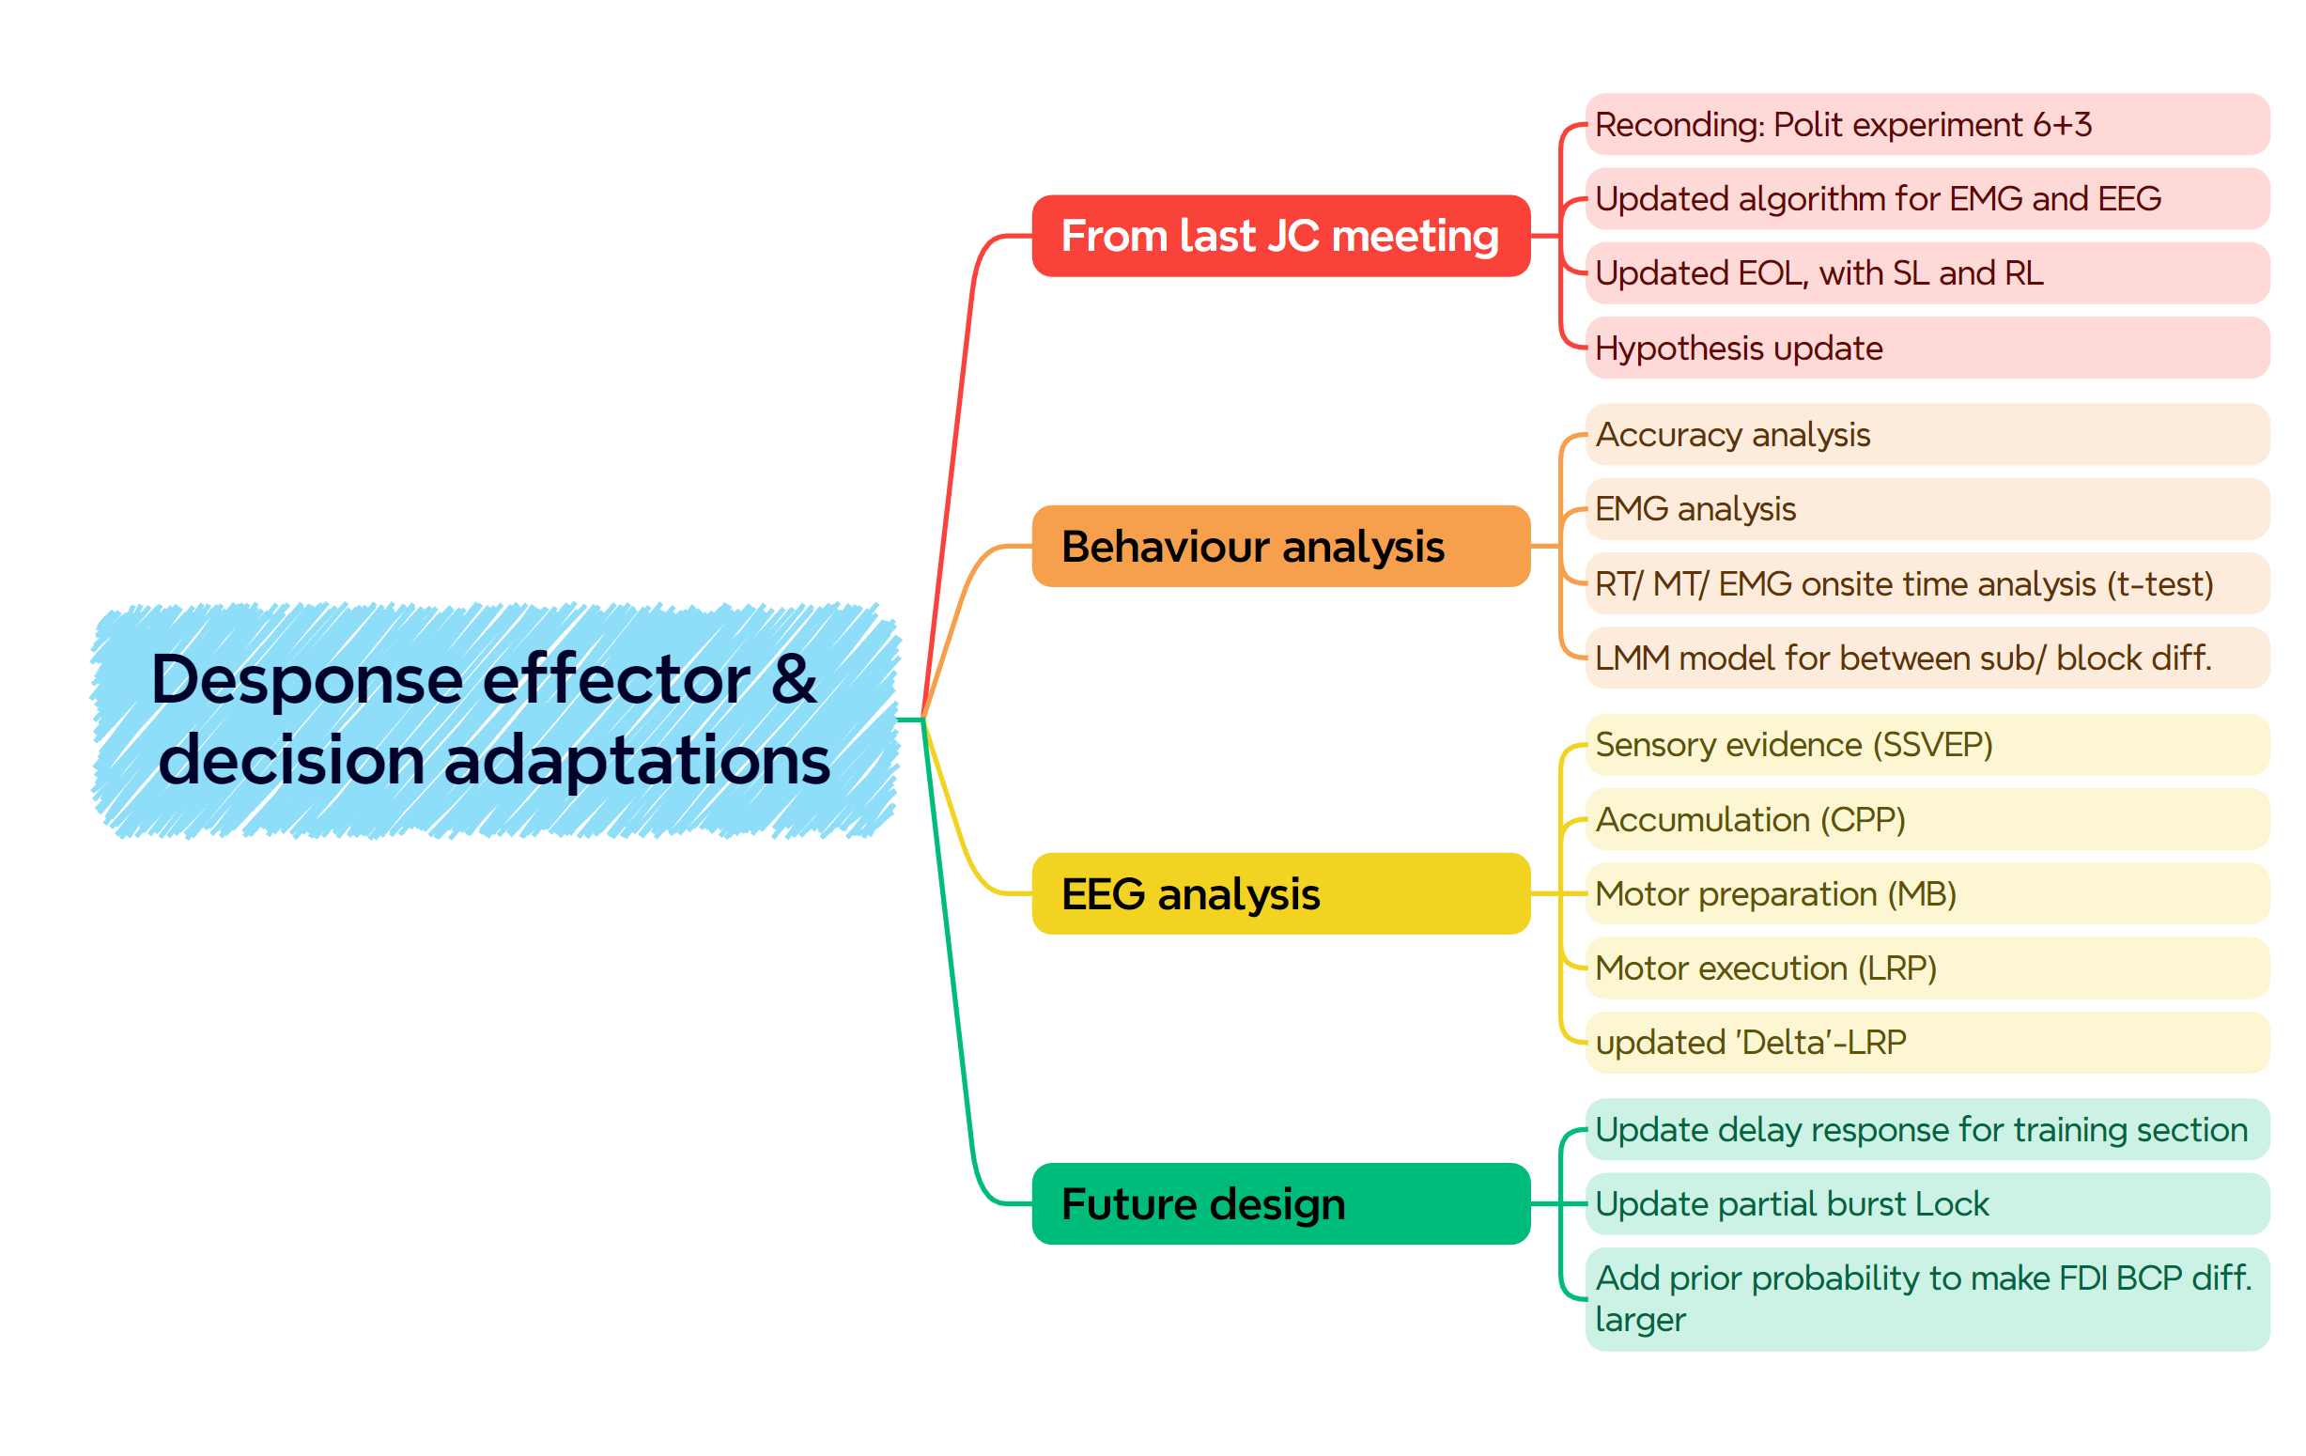

Slide 3
From last JC meeting
Polit experiment 6+3
Updated algorithm for EMG and EEG+ the reason choose EOL
Hypothesis update
Behaviour analysis
EMG analysis
SSVEP analysis
CPP analysis
MB analysis
LRP analysis- updated delta-LRP
Summary
Future design
Update delay response for training section
Update partial burst Lock
Add prior probability to make FDI BCP diff. larger

Slide 4
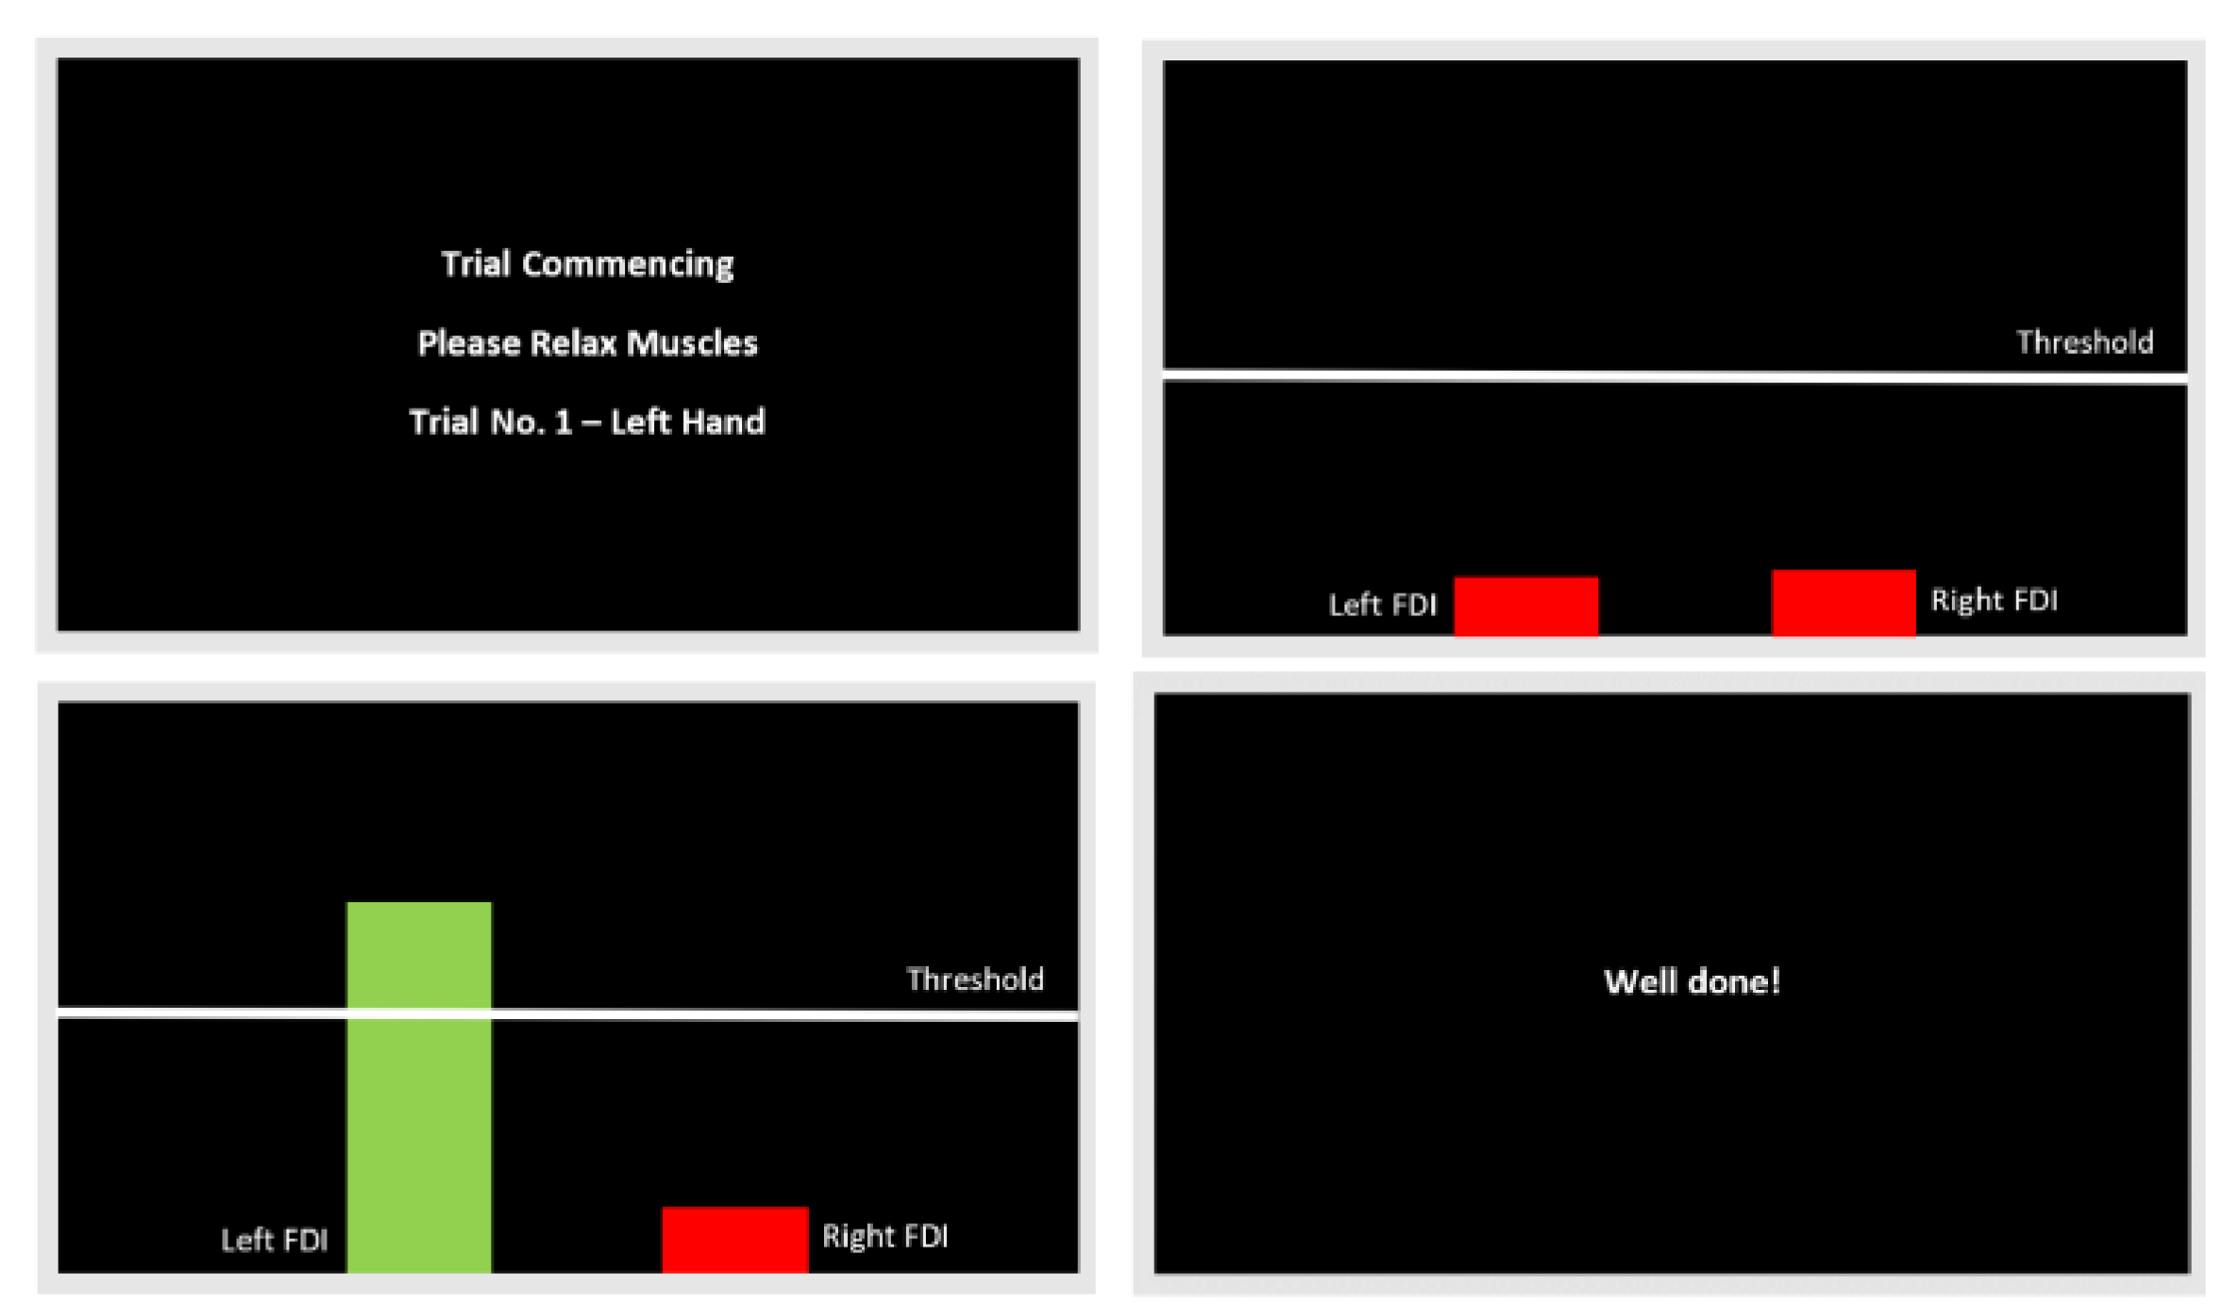
Polit Experiment (N=6+3)
Training section (real-time feedback)
10 min EMG calibration
15 min for force control training (20%)
15 min for contrast discrimination task learning
Notes:
特定阈值的肌肉激活作为反应，且将会提供施加力的实时反馈，频幕上显示进度条
参与者将会学习如何控制他们的FDI肌肉与BCP肌肉
1个力 (大力有维持的反应feedback loop，小力直接击穿) 需要测试出用大还是用小

Slide 5
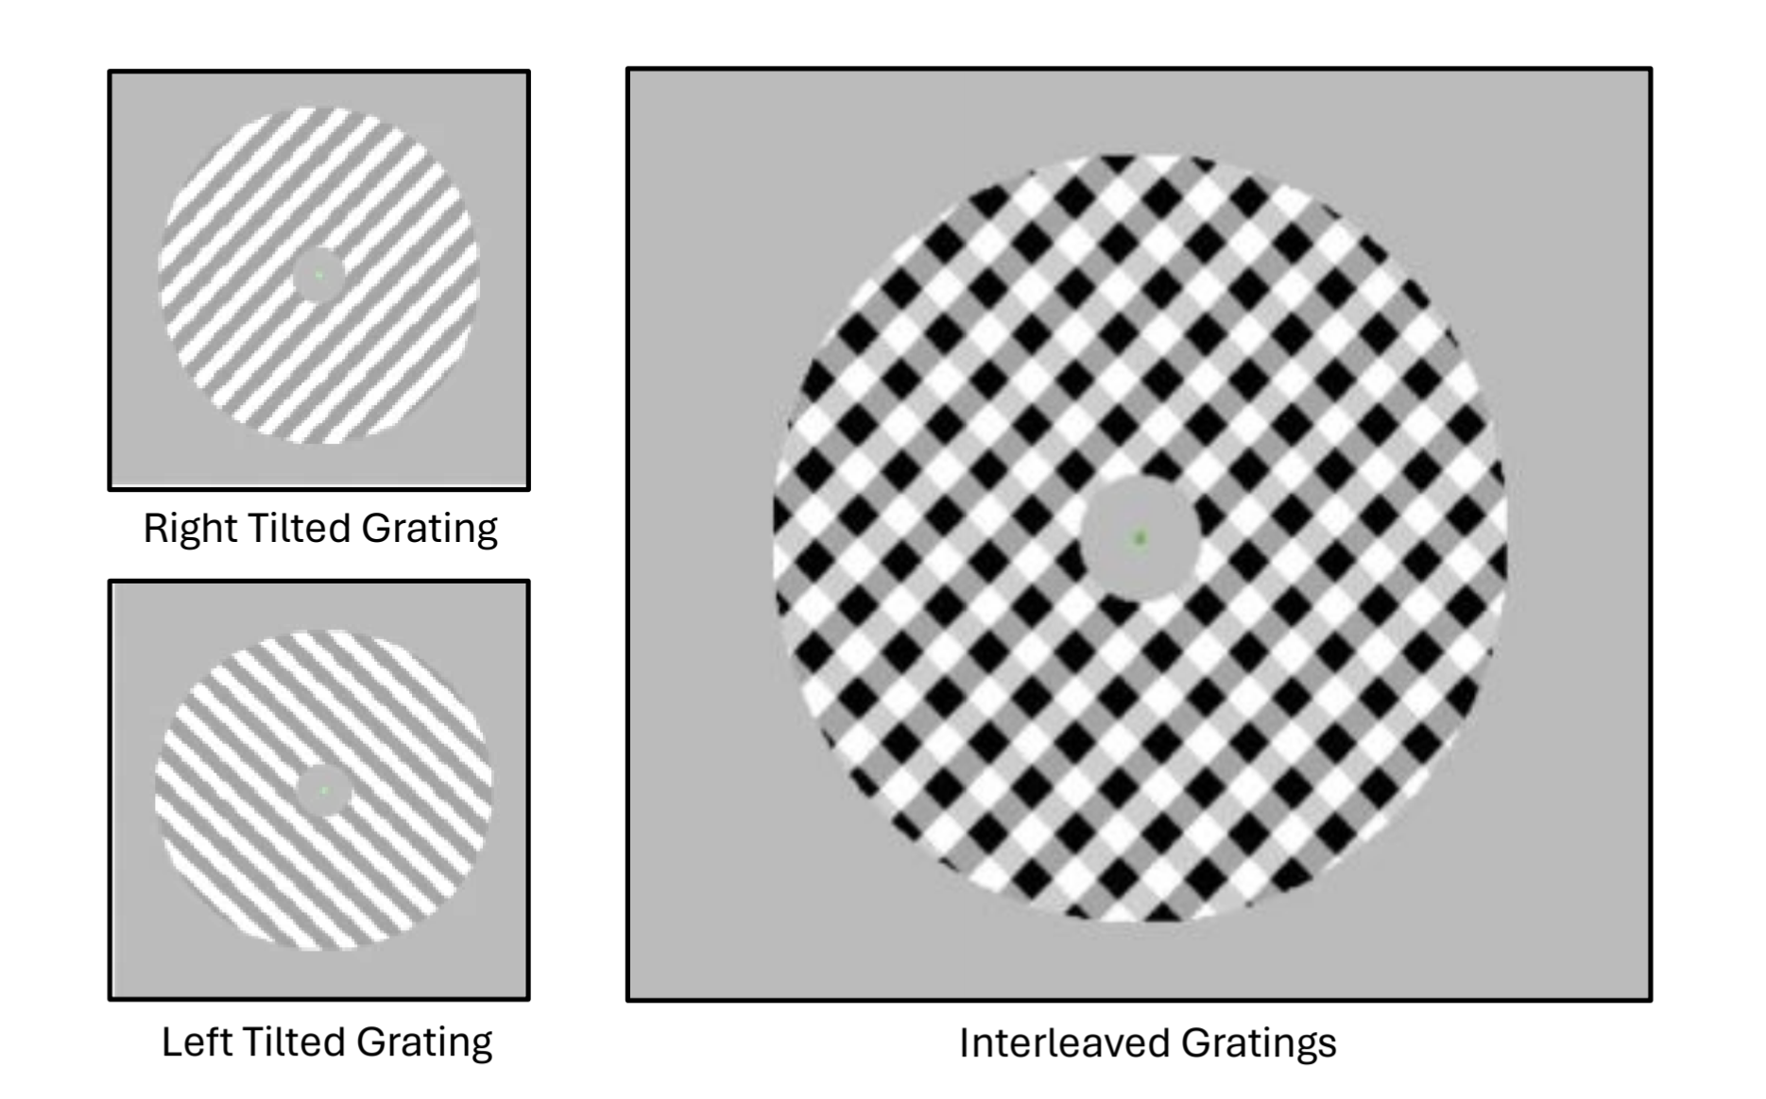
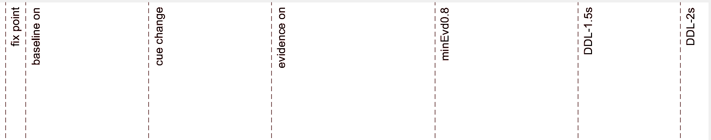
Polit Experiment (N=6+3)
2 Response effector – FDI and Biceps
2 coherence level – easy (0.14) and hard (0.07)
1 force level - 20% MVA
1.5s DDL - speed pressure
128*8s trials *8 blocks =85 min
256 trials* 4 conditions
EVon
0.8s – 2s
RT
0.2s – 1.5s
0.2s
EVoff
0.1s
0.6s
0.6s
0.8s
0.7s
0.5s
Notes:
contrast discrimination task 作为polit ；
两个难度two difficulty levels， 有15分钟训练时间从0.4降到0.1，准确率大于60%即可开始实验
下面是示意图，时间上有些改变，如800ms. 主要不同是反应阶段
1.5秒有速度压力 偏向速度权衡

Slide 6
Updated algorithm
Auto EEG preprocessing pipeline - ready
EMG postprocessing pipeline 1: linear envelope (ENV) (RMS method)
EMG postprocessing pipeline 2: Fuzzy Entropy (Z-score to balance noise )
EMG valid check manual pipeline (also for count partial burst)
New EMG onsite Lock in addition to SL,RL
‘Delta’ – LRP
LMM model for behaviour analysis

Slide 7
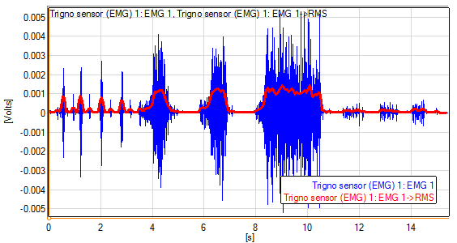
the reason of EMG postprocessing pipeline 2: - partial burst + EOL
Method 1: But not sensitive to capture small signal + noise. (which is important in DTDM model!)
Starting time not accurate
Figure 2: Three contractions on each channel of the EMG signal; The red line represents the region where the muscle contraction is ‘on’

Slide 8
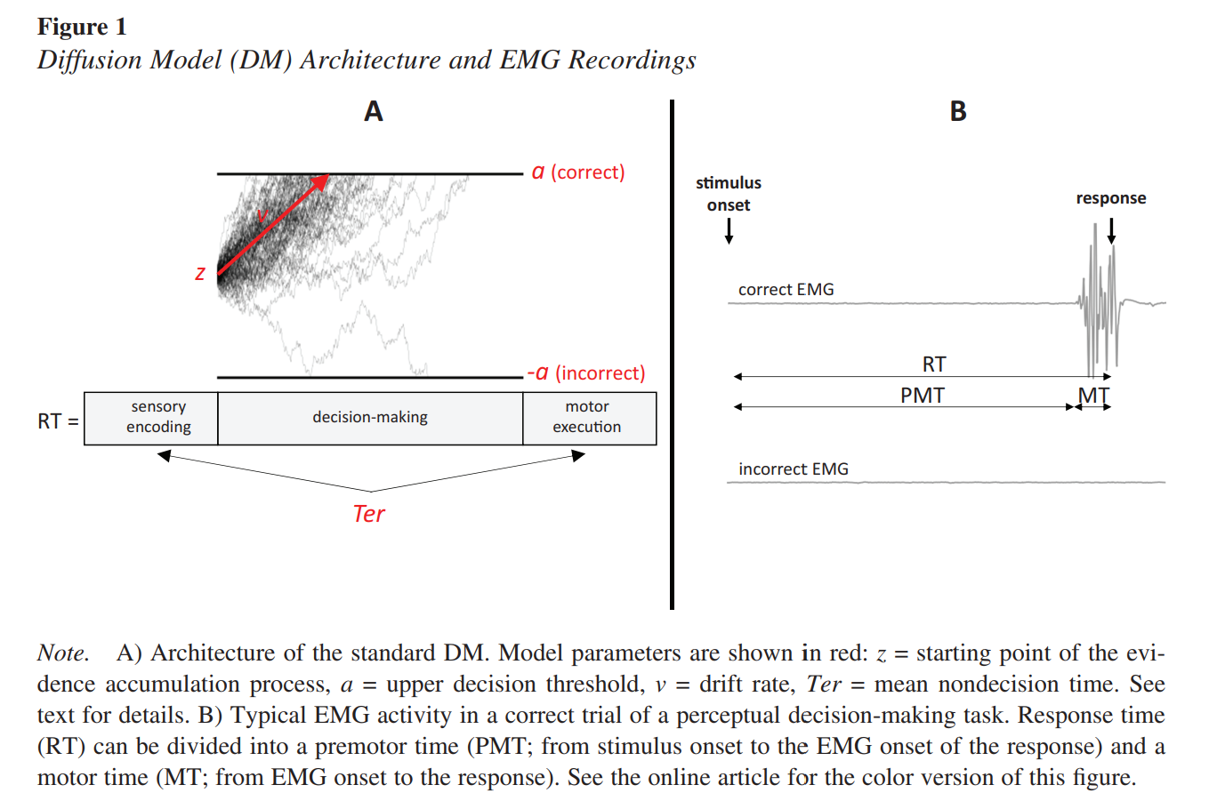
nondecision time 300-400ms
sensory delays (220ms)
motor delays (80ms)
RL
SL
EOL

Slide 9
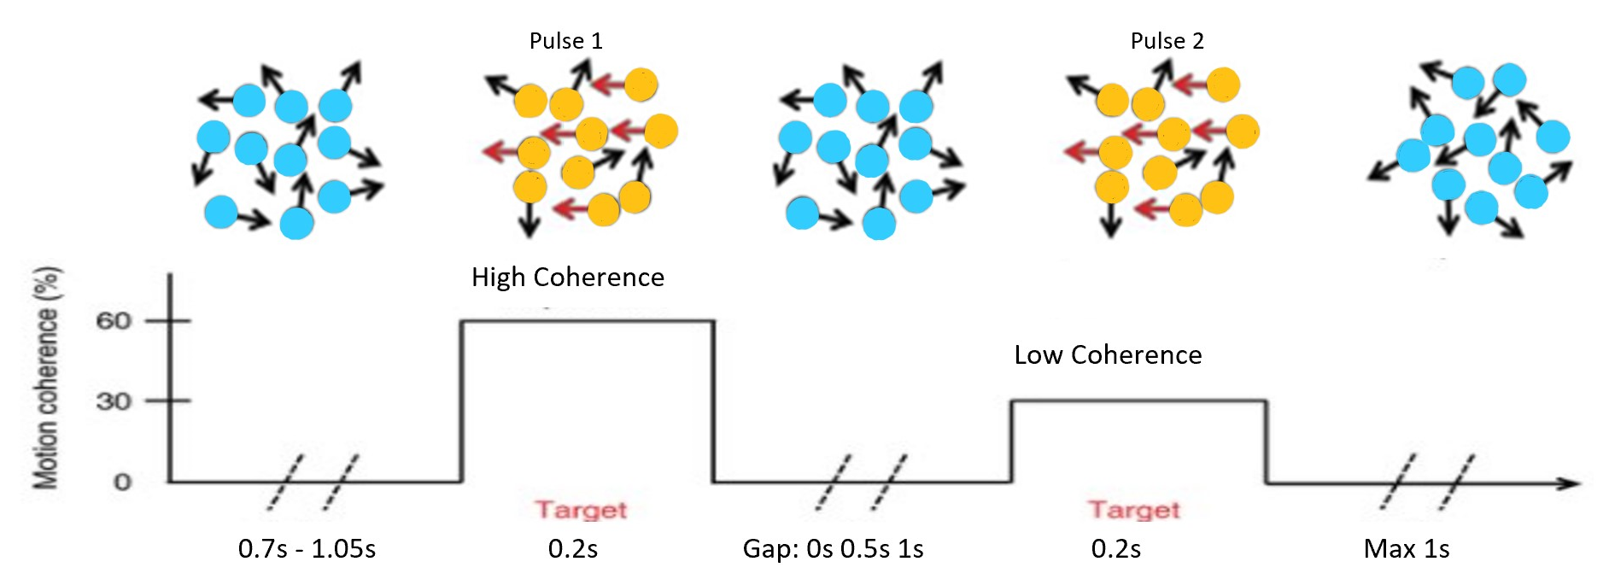
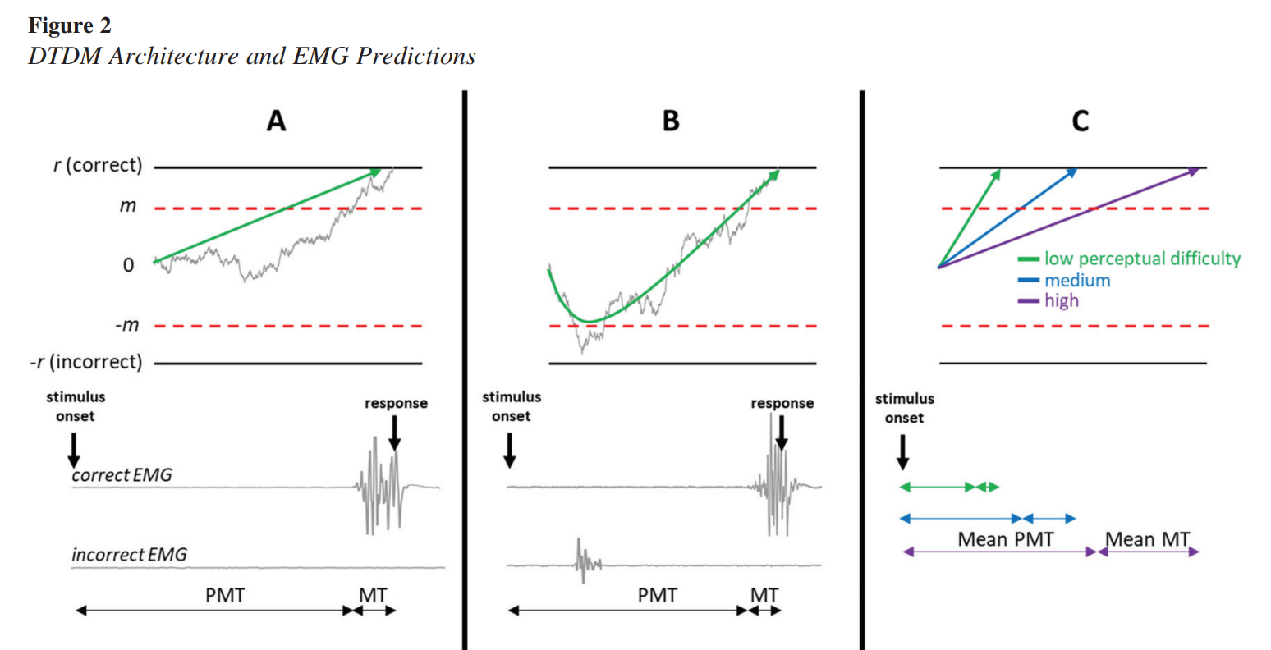
EMG model- DTDM
When coherence ⬇
PMT & MT monotonically ⬇
Drift rate ⬇
Partial bursts number ⬆
First partial burst time ⬆
* Similar to CoMs

Slide 10
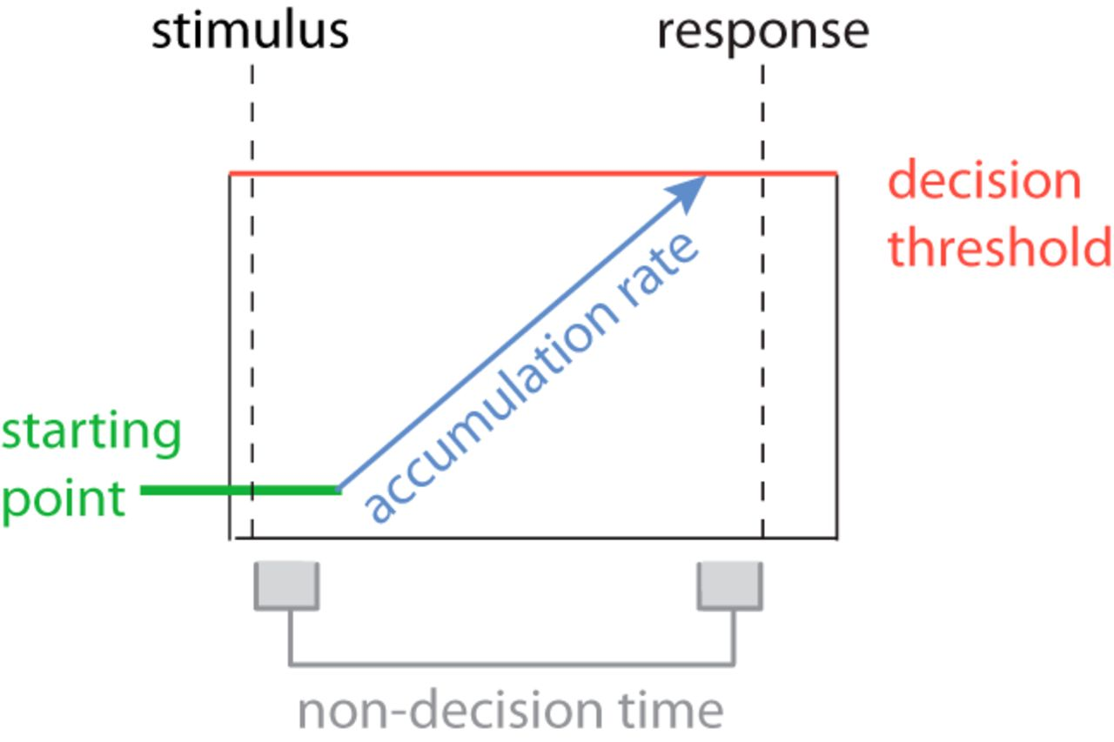
the reason choose EOL- focus on Motor process
SSM can’t distinguish three decision process
Motor process is simplified as delay
Decision adaptation between sensory to motor area is muscle dependence (FDI vs BCP)?
So we need precise timing of decision commitment
Notes:
1.SSM 不能区分三大进程sensory，cognitive， motor
2.大多数决策用简单动作（按钮或鼠标），造成两个问题。第一把motor process 简化为delay，第二集中在远端肌肉，但假肢用近端比较多，且手与脑区的链接比手臂多且复杂
因为大多数DM操作的是sensory和cognitive 层面，有了EMG界面的帮助可以操作motor 层面, 且可以确定决策commitment

Slide 11
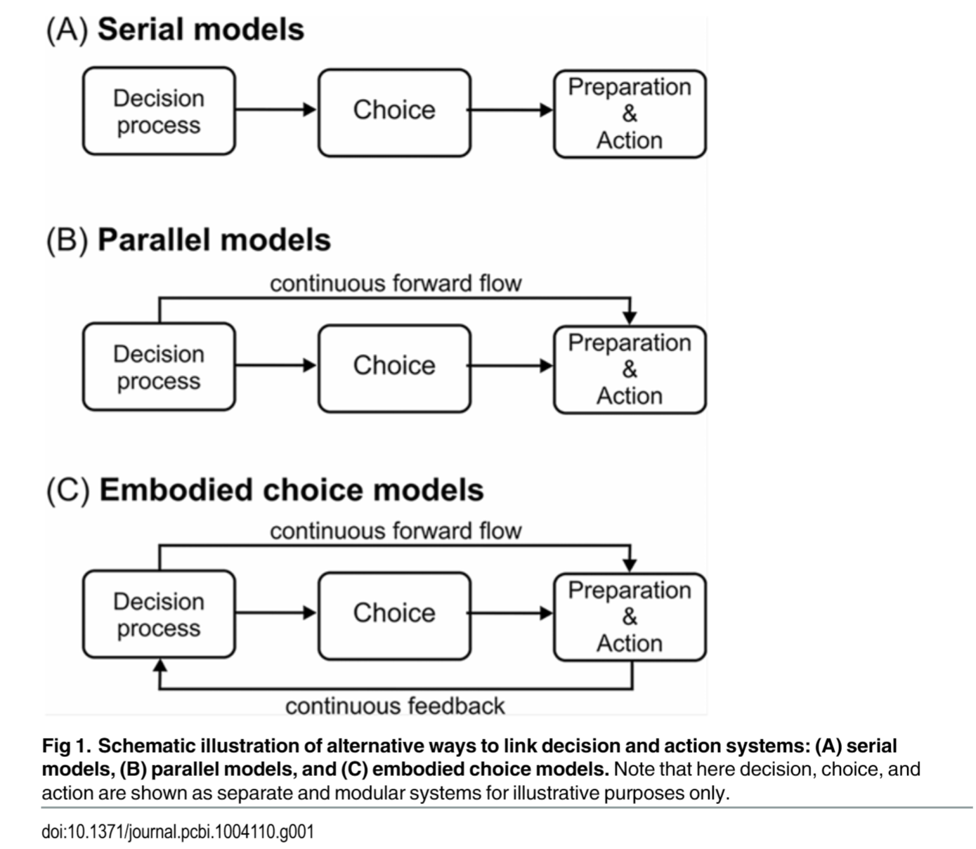
Decision making model type

Slide 12
Hypothesis update
Sensory evidence
Motor preparation
Accumulation
Motor execution
BCP=FDI
BCP is more Serial model
FDI have more continues forward flow+ feedback loop
BCP MT faster than FDI (Behaviour analysis)
No partial EMG burst in biceps (EMG analysis)
Same sensory input (SSVEP)
More medial areas of the motor cortex for BCP (scalp plot, LRP)
BCP PMT & MT monotonically decrease (CPP; MB)
Different participant different psychology kernel (LMM)
Between block there’s learning activity (LMM) – delayed feedback
BCP>FDI (easy to acc) faster
BCP<FDI (less connection)
BCP>FDI (easy to excu) faster

Slide 13
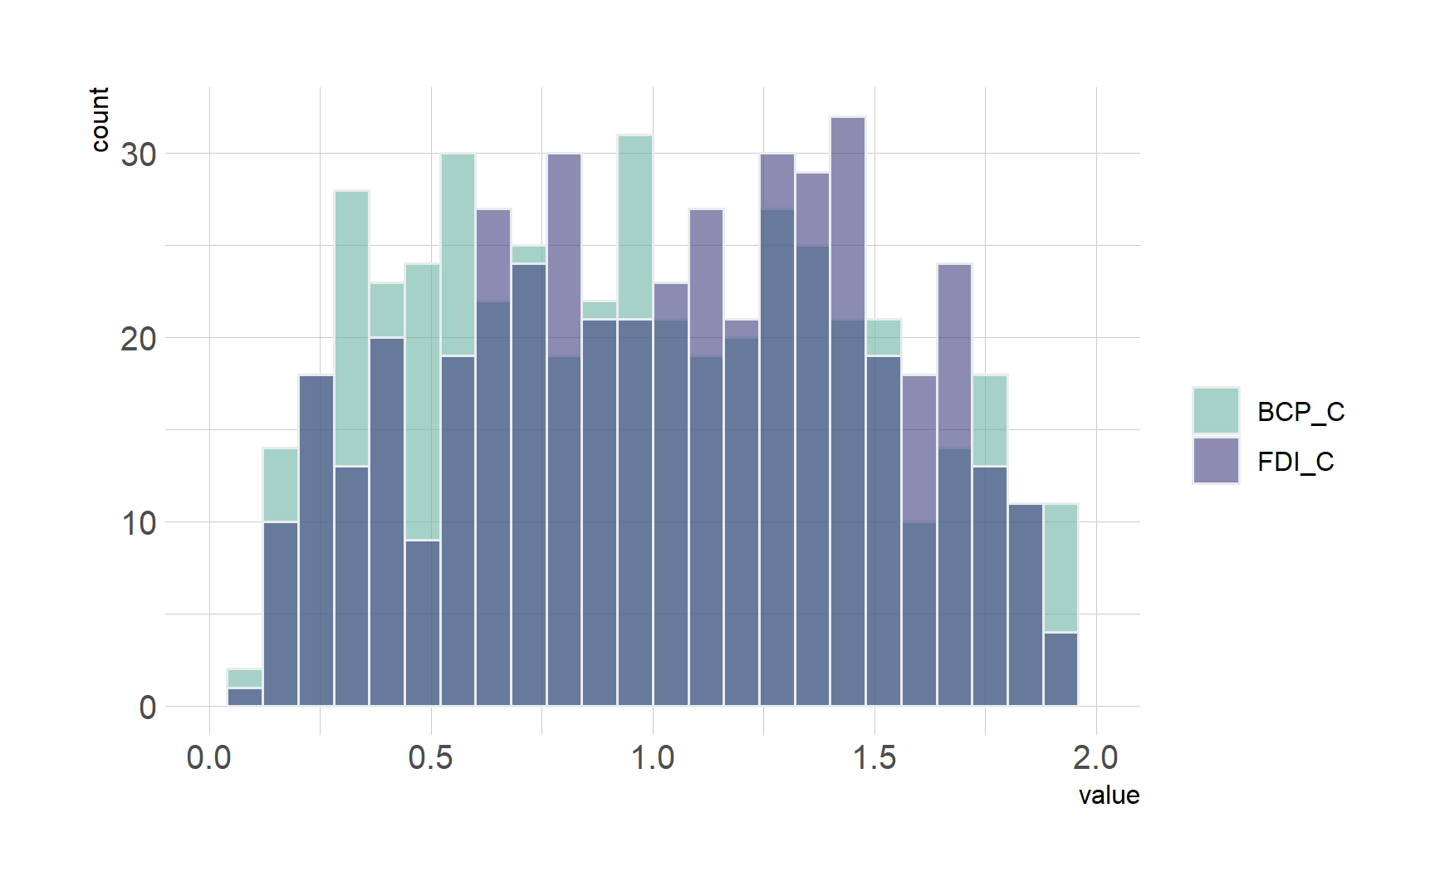
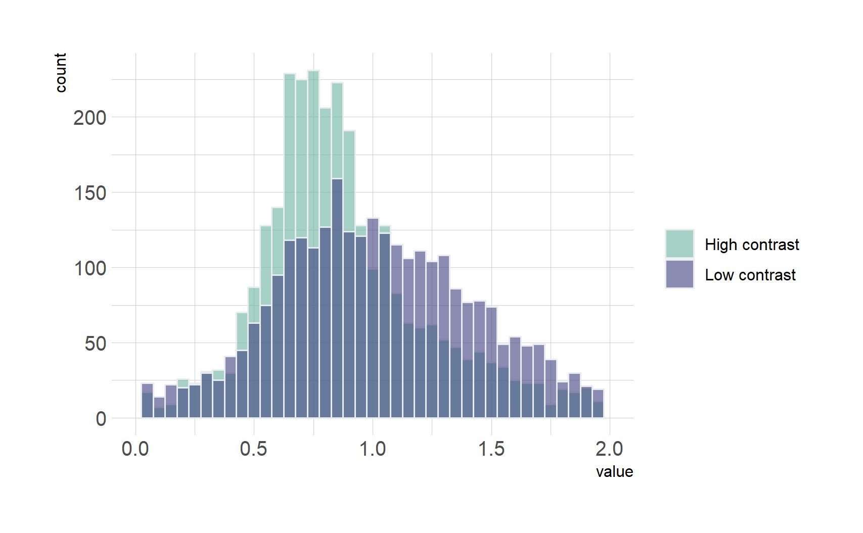
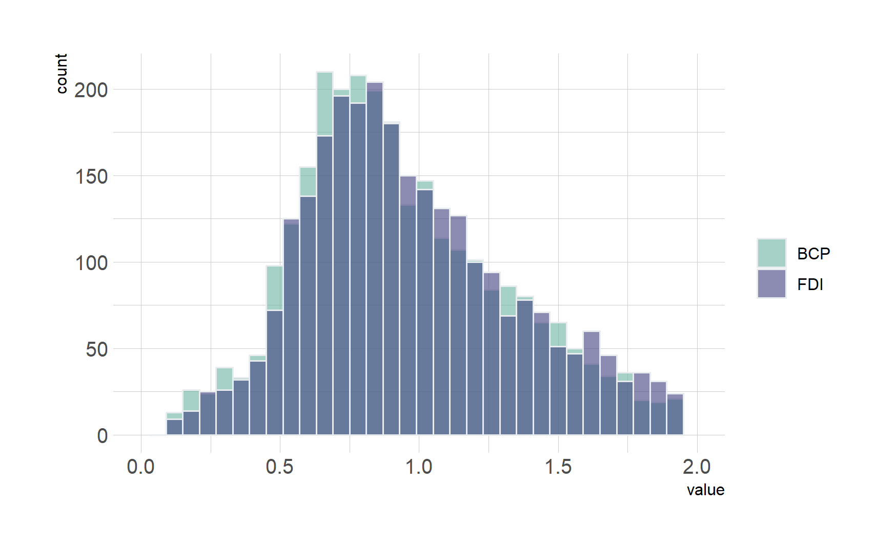
Behaviour analysis
accuracy Summary
no clear difference in acc between FDI and BCP 82%
Easy (0.14) has higher ACC 89% vs 80%
RT Summary
correct RT is faster than Wrong RT
BCP is 20-30ms faster than FDI in RT=PMT+MT
Low(Hard) slower RT , more symmetric, High(Easy) more right screw;
left is around 80ms (45 correct 120 for wrong) slower than right response (all right hand user)

Slide 14
MT=RT- EMG onsite
p-value: 1.8912e-100
Confidence Interval: 0.036577 to 0.04378
BCP Motor time 36ms-43ms faster than FDI
Diff. shape means different DM strategy?
FDI 100ms faster; BCP 60ms faster (use for EOL update)
MT=RT- EMG onsite
Summary Statistics for Data1:
Mean: 0.103
Median: 0.093221
Standard Deviation: 0.065253
Min: 0.00012133
Max: 0.39156
Interquartile Range (IQR): 0.074934
Summary Statistics for Data2:
Mean: 0.062822
Median: 0.057436
Standard Deviation: 0.044239
Min: 4.1341e-05
Max: 0.35746
Interquartile Range (IQR): 0.059474

Slide 15
EMG onsite FDI still faster!
MT has difference
Pre MT also has difference
FDI’s Per-MT is 60ms-10ms faster than BCP
p-value: 9.7893e-05
Confidence Interval: -0.060306 to -0.01995
Summary Statistics for Data1:
Mean: 0.87079
Median: 0.79414
Standard Deviation: 0.38769
Min: 0.0027547
Max: 1.9785
Interquartile Range (IQR): 0.51105
Summary Statistics for Data2:
Mean: 0.91092
Median: 0.84486
Standard Deviation: 0.37584
Min: 0.0027623
Max: 1.9819
Interquartile Range (IQR): 0.50655

Slide 16
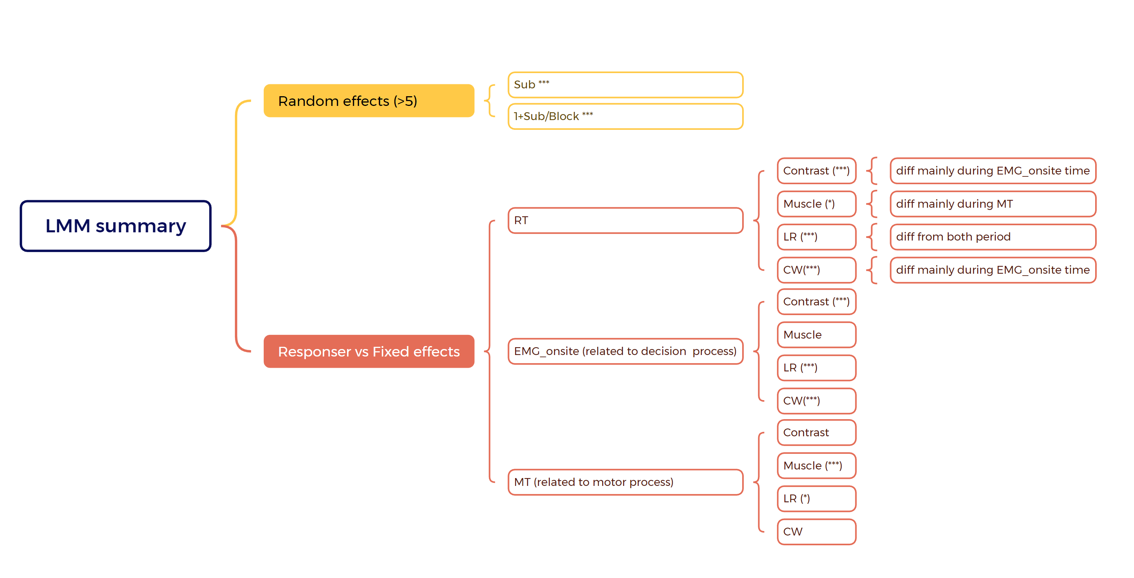
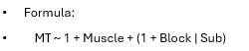
RT analysis

Slide 17
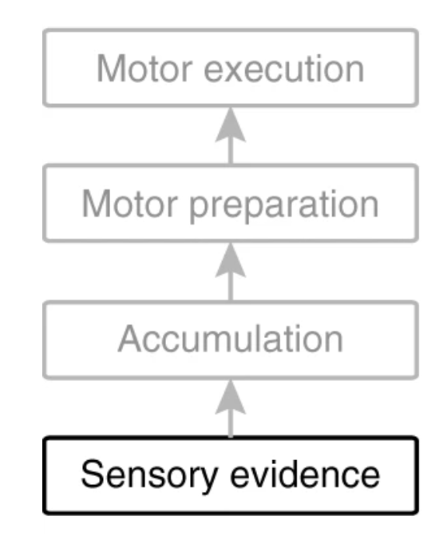
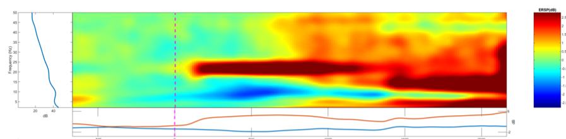
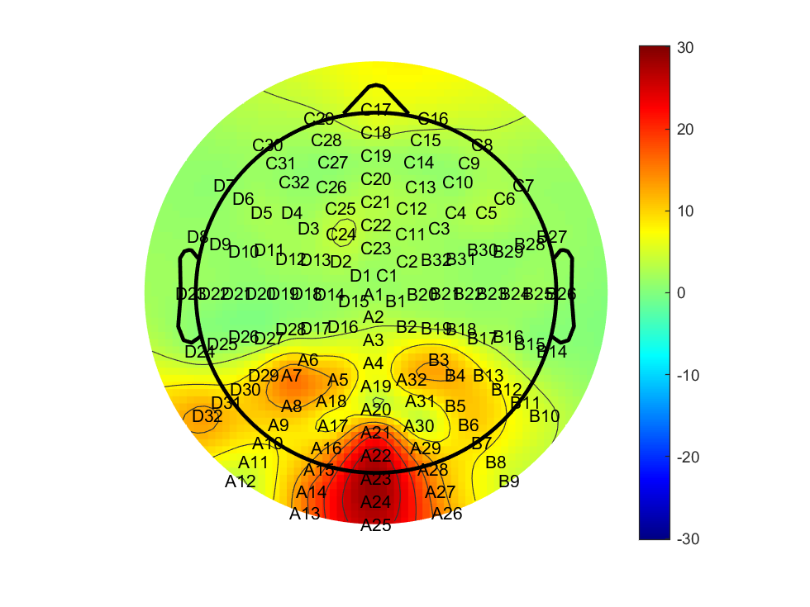
SSVEP (21.5Hz)
Low vs high
bright first and dim first are opposite phase

Slide 18
Low vs high(correct vs wrong)
Low vs high(correct vs wrong)

Slide 19
BCP (2) slightly higher at first but lower slop, lasting longer FDI higher in the steady stage

Slide 20
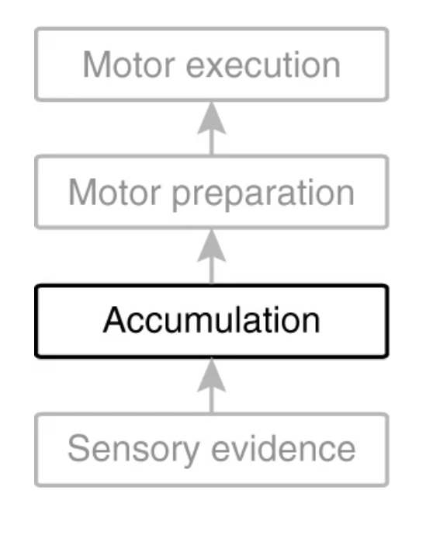
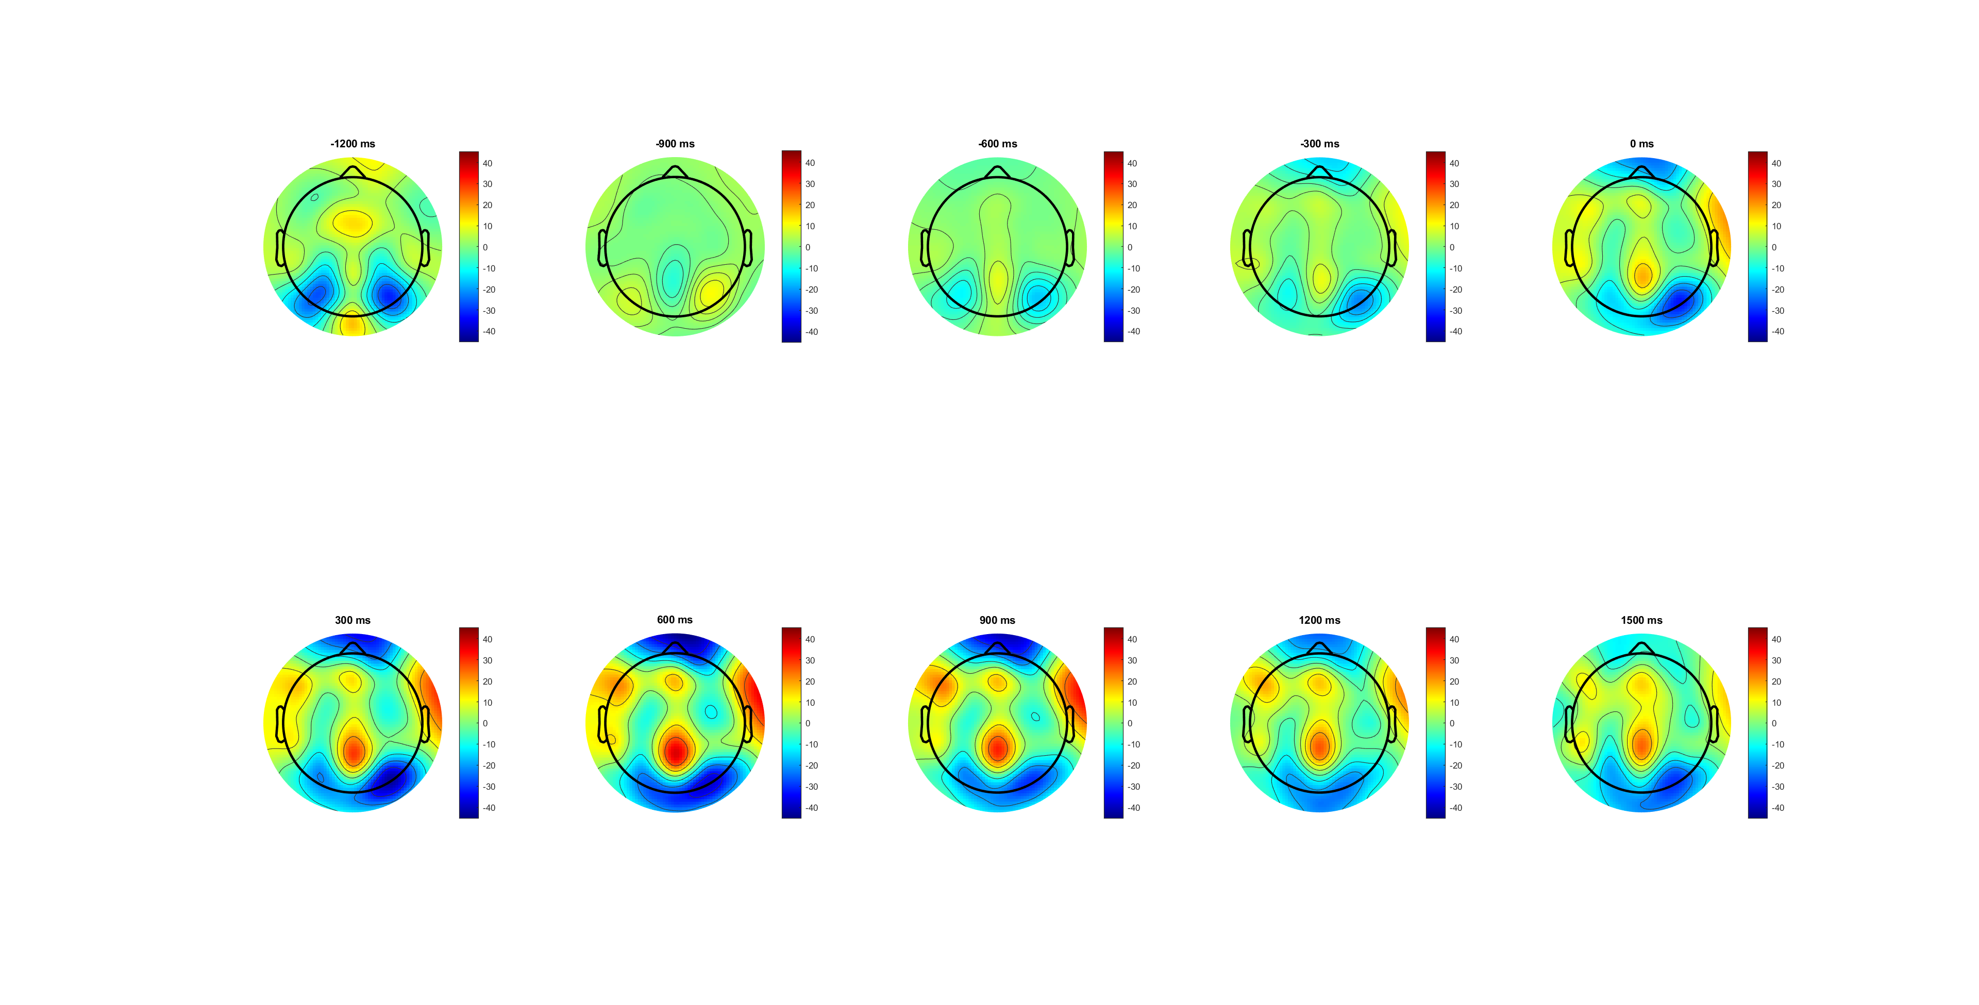
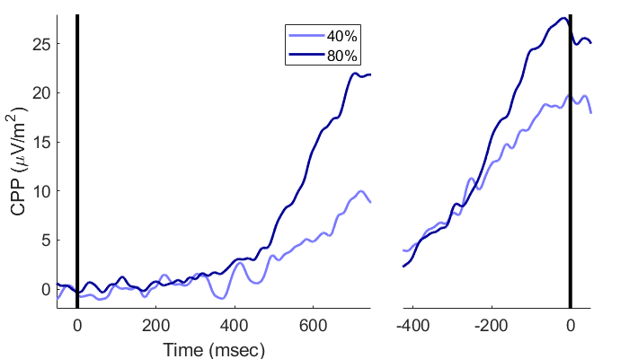
CPP

Slide 21
Notes:
Cue后300开始积累， ev后300出现斜率差异
可能是由于速度压力或者是实验者把cue当成evon导致的

Slide 22
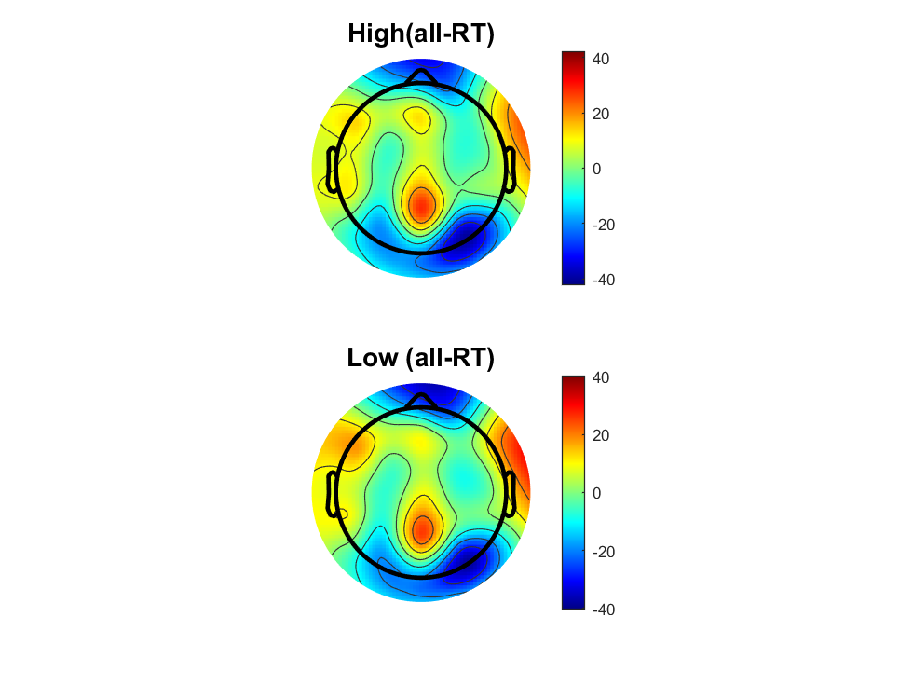
Notes:
H amplitude更大，且L更波动，到达高点后维持更长时间
Q-RT 斜率更大

Slide 23
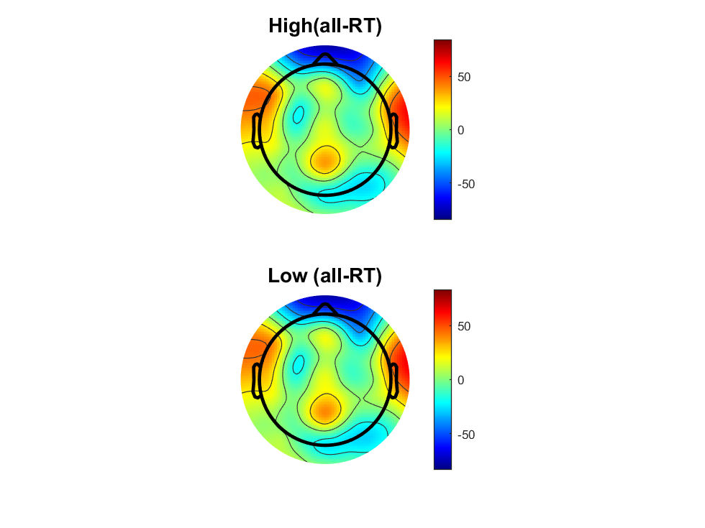
Notes:
L快速应答不足，所以M和Q区别不足

Slide 24

Notes:
EOL的0点更提前，更好的区分MT和PMT

Slide 25
Notes:
SL：斜率不同，BCP阈值更高（假设为线性模型）
RT: BCP斜率更大，所以FDI更快； 但是这种差异是MT不同导致的（整体后移）
EOL: BCP有更快的RT(为证明其中加快是来自MT or PMT),需要EoL，（证明差异大部分来自MT,EOL后斜率不同）
结合行为数据与EOL，似乎BCP更快的RT来源于MT（EMG onsite后的斜率差异， 可能PMT中仍存在（有一种假设是按比例减少），需要更大数据集

Slide 26
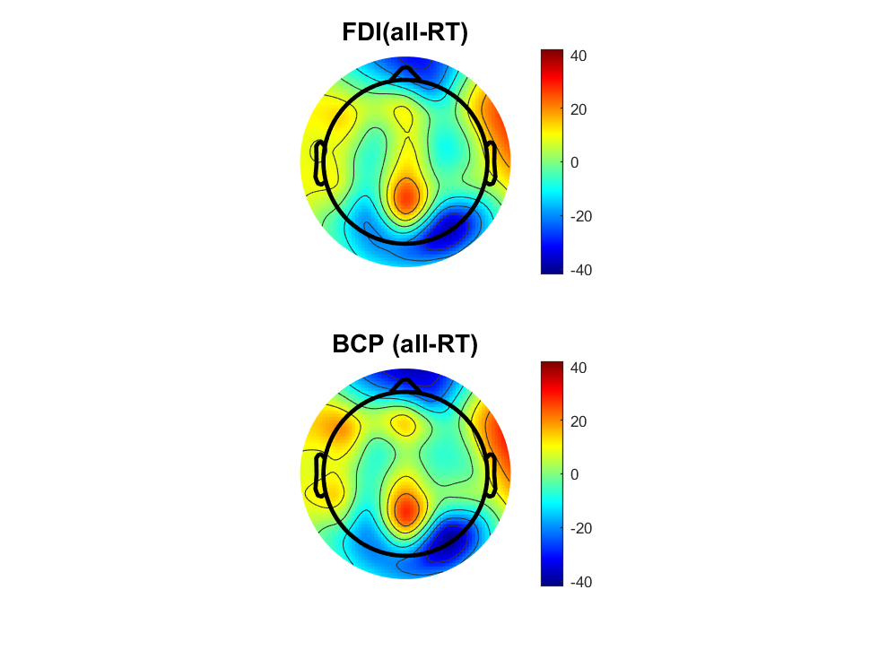
Notes:
FDI三种时间peak相同，斜率不同
BCP三种时间oeak不同。斜率MandS比较晚出现斜率不同 （三种RT 对BCP影响可能较大）

Slide 27

Notes:
FDI三个时间斜率不同
BCP尤其是M和Q,斜率相同，只是发生时间有延后 (暗示触发反馈的神经机制一致，更像线性模型)
S在两个区别不大，可能是缺少了由MT/PMT不同引起的bais，或者单纯注意力不集中的Trial

Slide 28

Notes:
EOL消除不同MT带来的差异
FDI饱和点更集中
BCP最高点出现的时间差异减小（但仍然存在，加入新假设，BCP对于不同反应速度的MT差异更大？）
如果增加数据量，还能在BCP里观察到斜率不同，则两个假设都成立（线性模型+MT时间对于不同RT差异更大（因为更难控制20%的力））

Slide 29
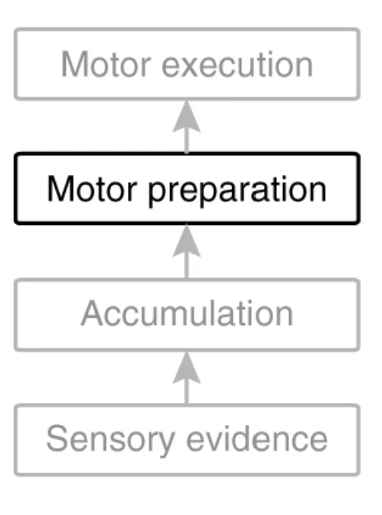
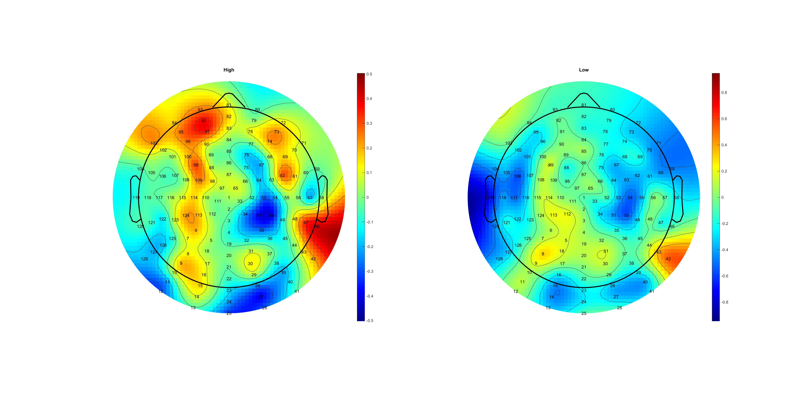
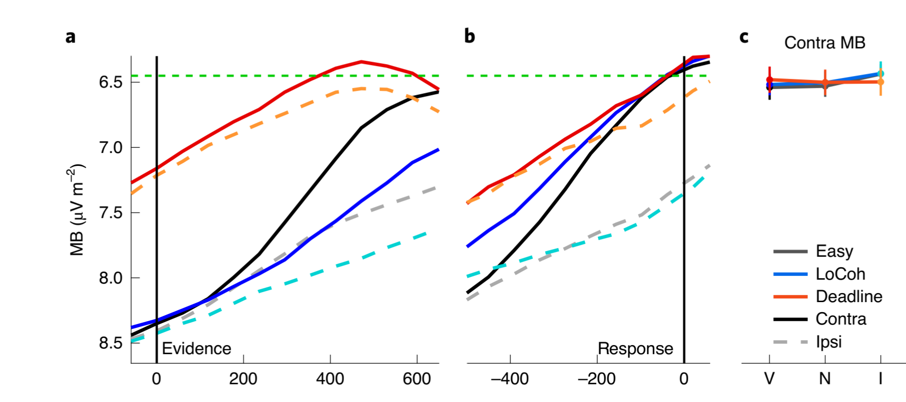
MB analysis
Wrong and low 0.07 have higher MB amplitude
BCP higher MB amplitude
Location: FDI wider and middle; BCP narrower and frontal

Slide 30
FDI (C3/4+) BCP (C3/4+)
FDI (C3/4+) BCP (C3/4+)
The lateralization (left- right) of BCP is more obvious than that of FDI
*muscle amount diff/ control diff
Notes:
在evidence前就存在low beta活动，考虑拖影的话在cue change 后

Slide 31
116 55
C3+116 C4+55
BCP is in mu /low beta band is higher, and FDI is higher in high beta band
Notes:
Cue变后FDI与bcp的区别开始在beta中段被发现，

Slide 33
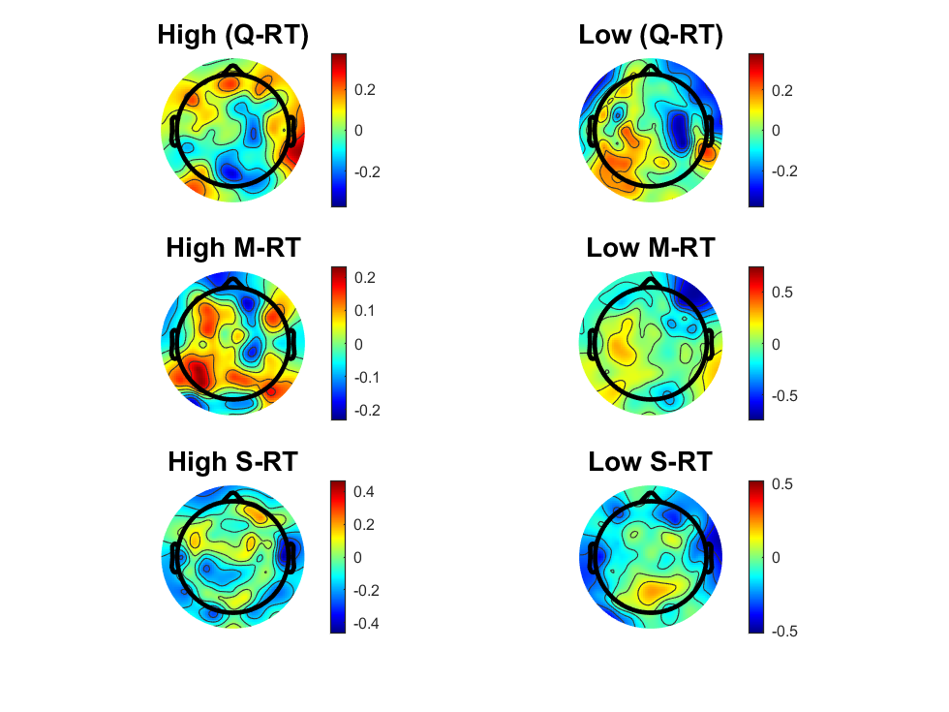
MuBeta_SL_HL.mat
Notes:
虚线表示样本数量不足，H会缺少慢速应答，且会被走神引起的反应慢扰乱。 L缺少快速应答，且会被预先准备的左右手扰乱。

Slide 34
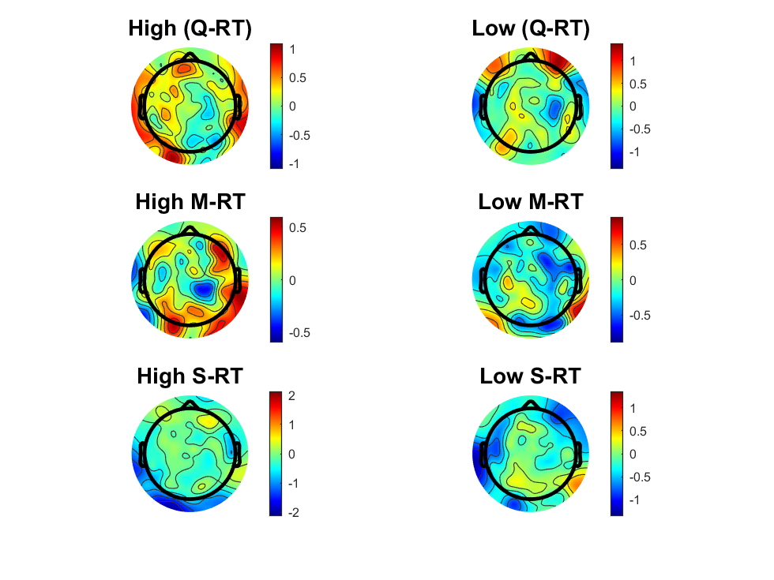
MuBeta_RL_HL.mat

Slide 35
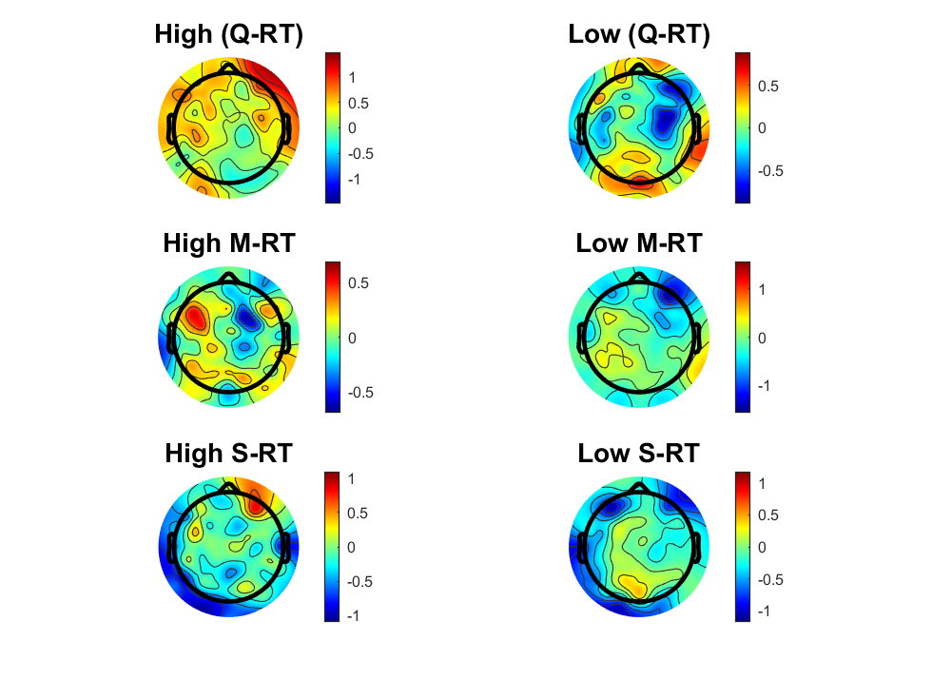
MuBeta_EOL_HL.mat

Slide 36
Notes:
Porir??

Slide 37
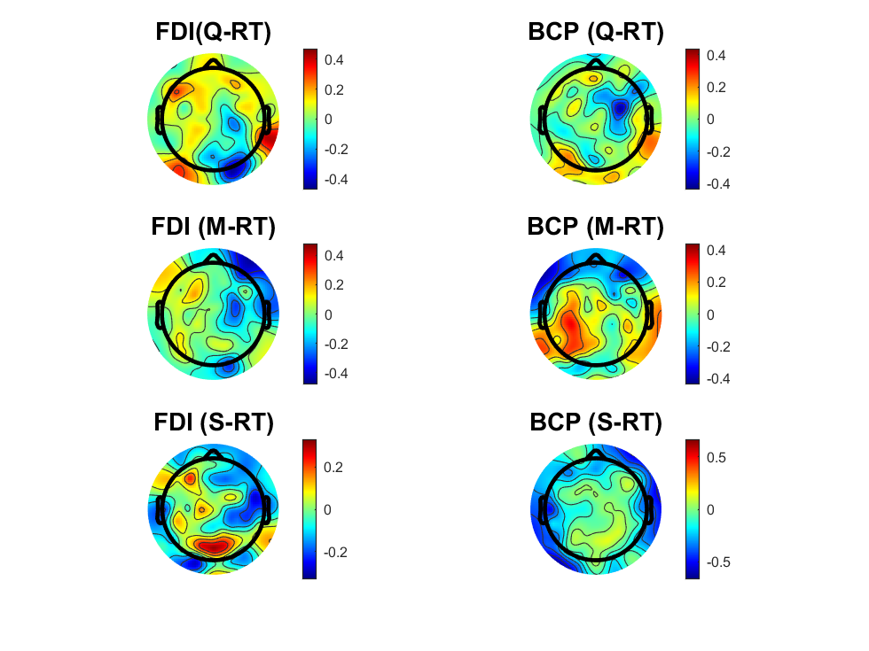
MuBeta_SL_FDIBCP.mat

Slide 38
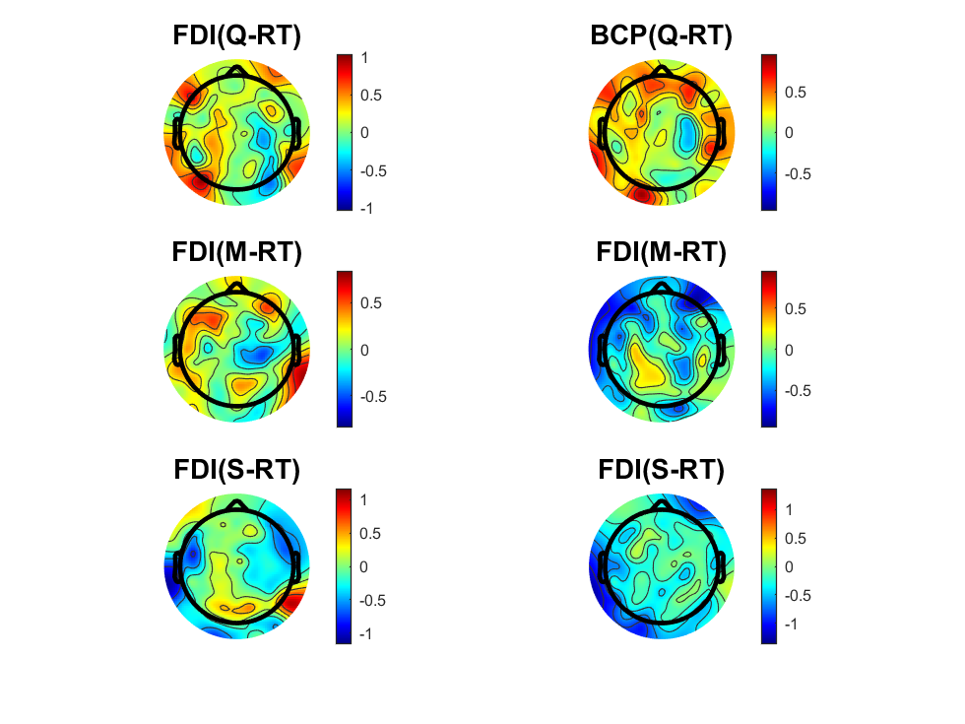
MuBeta_RL_FDIBCP.mat

Slide 39
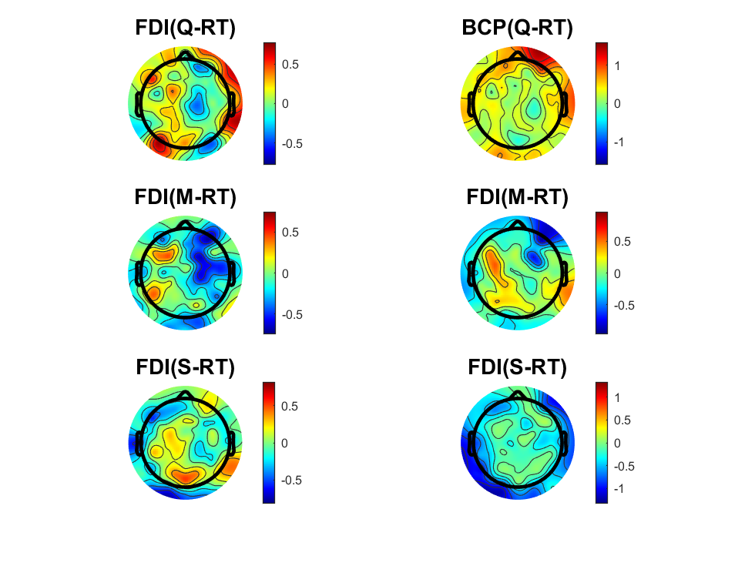
MuBeta_EOL_FDIBCP.mat

Slide 40
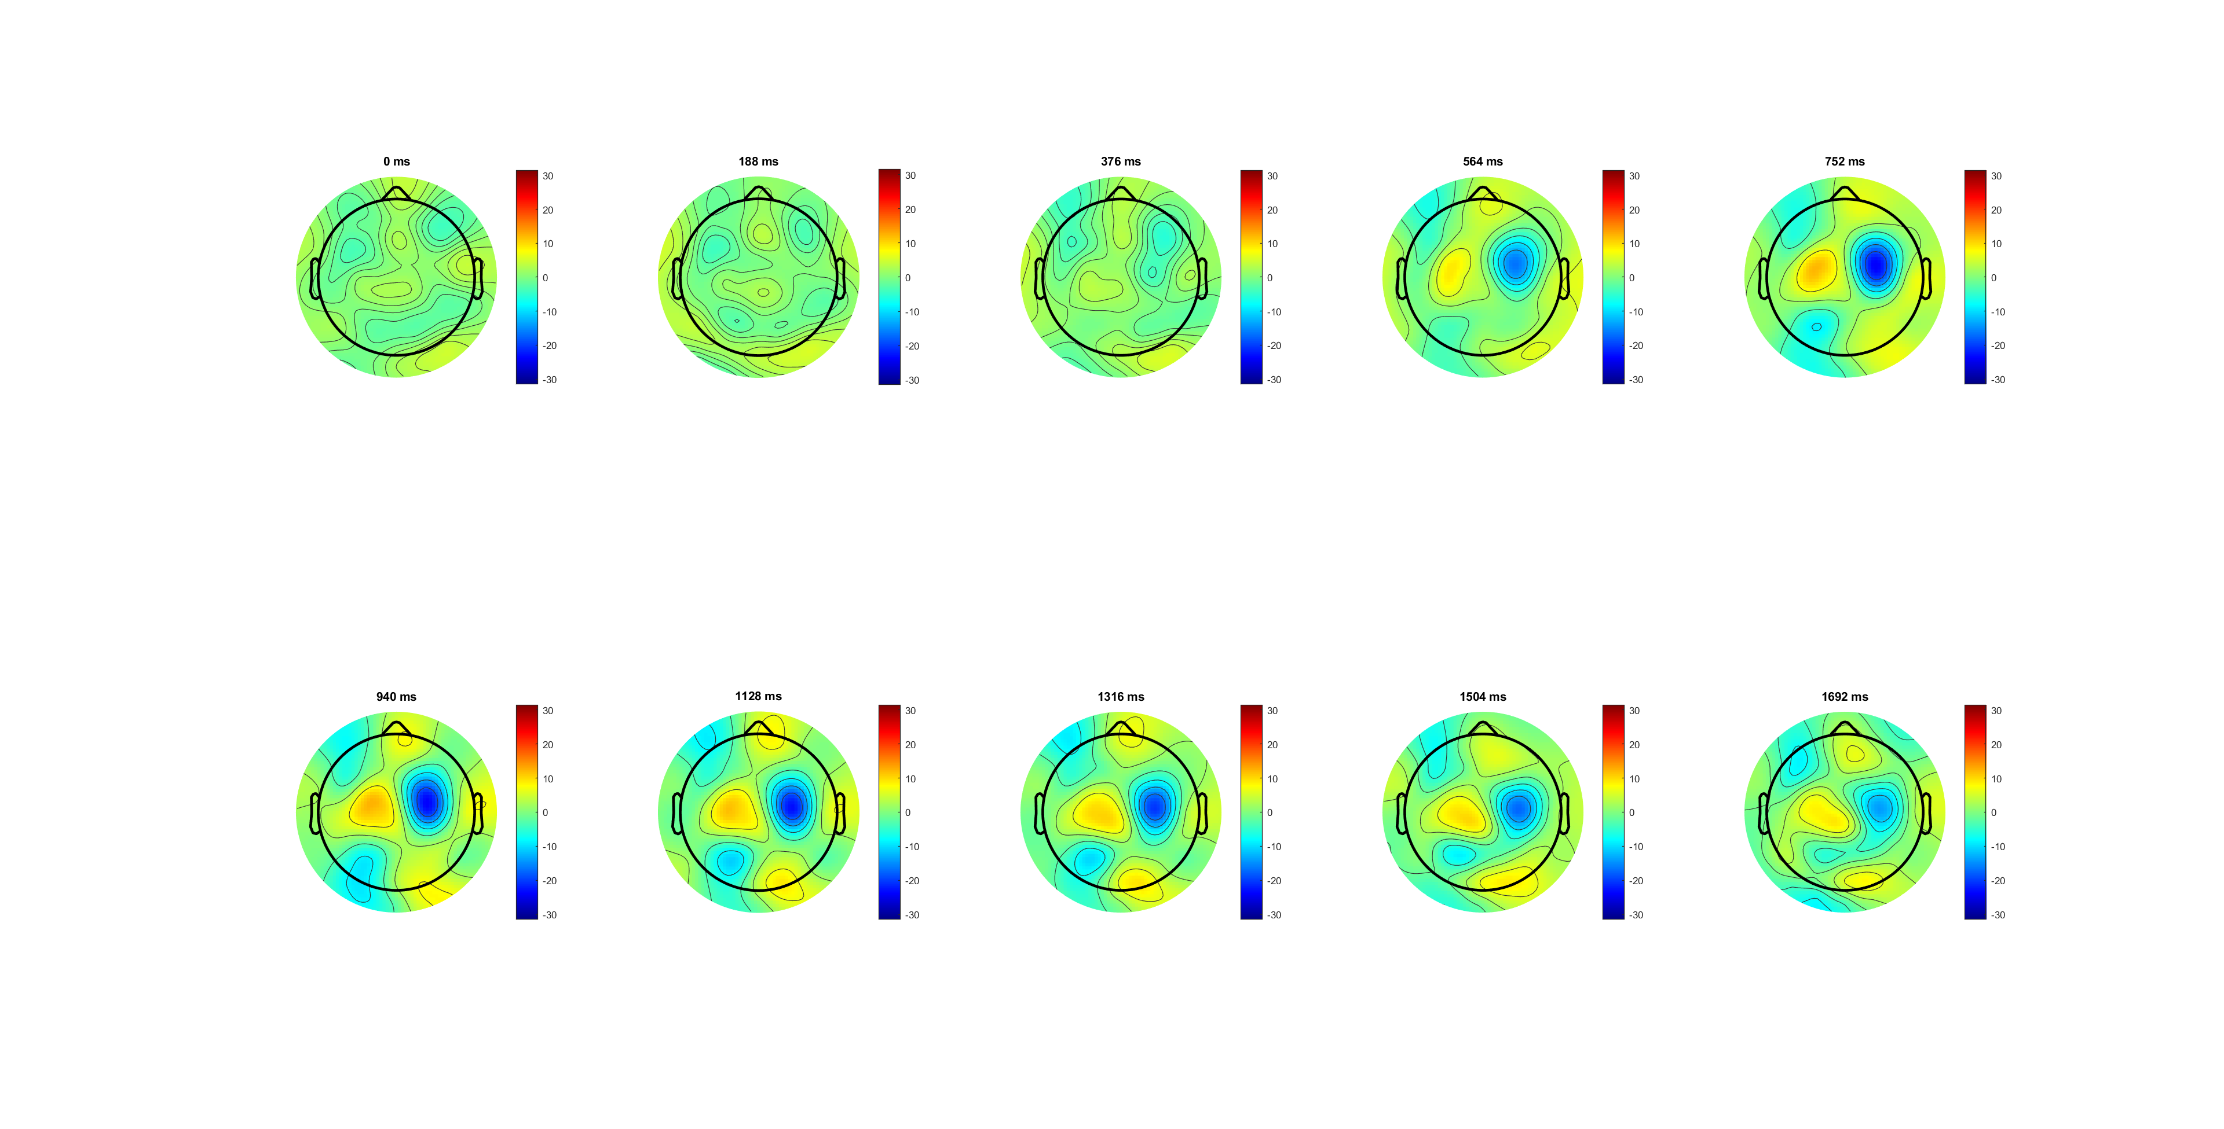
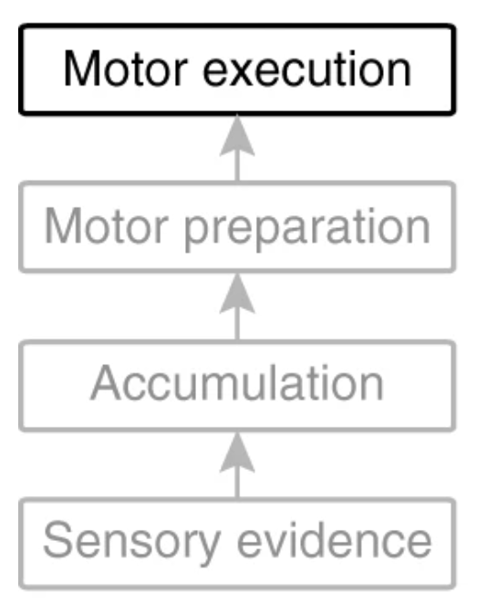
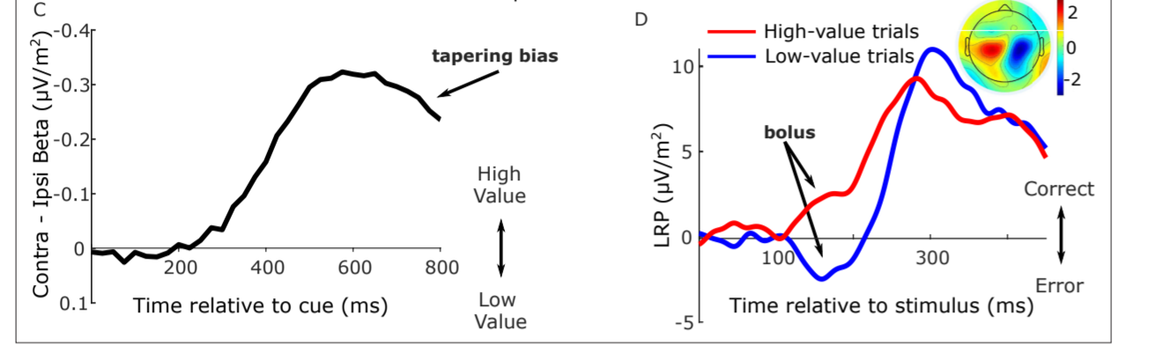
LRP analysis

Slide 42
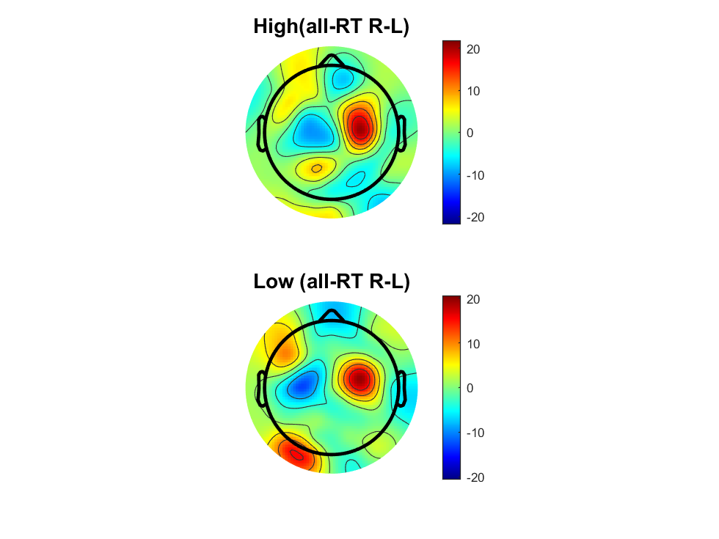

Slide 43
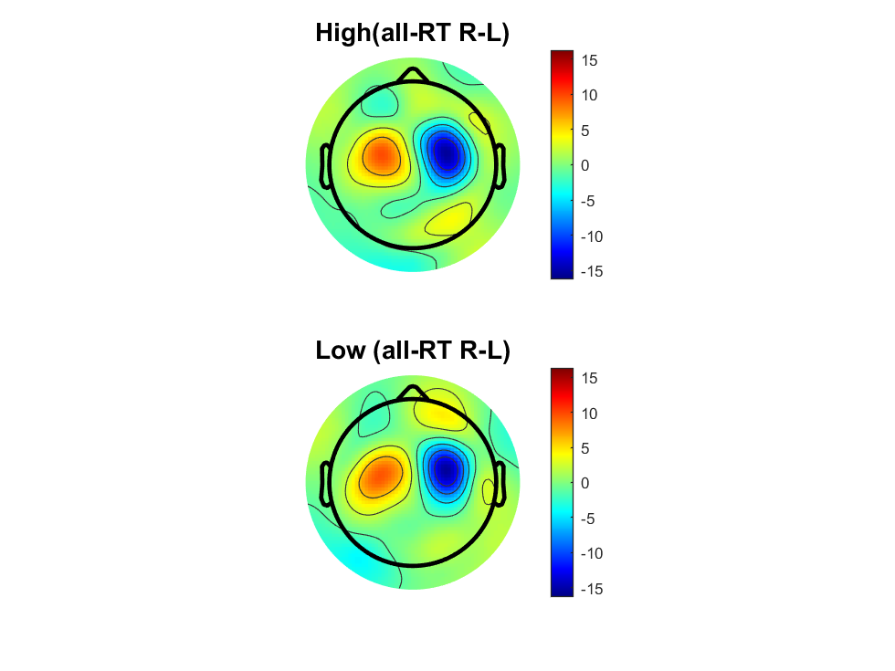

Slide 44
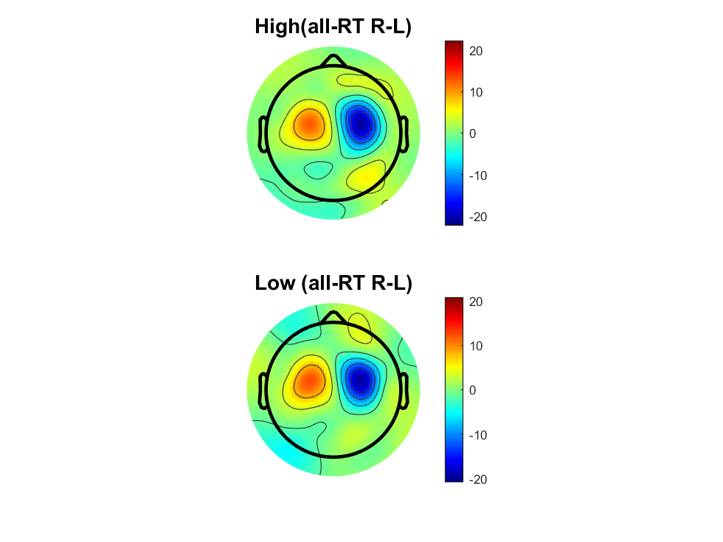

Slide 46
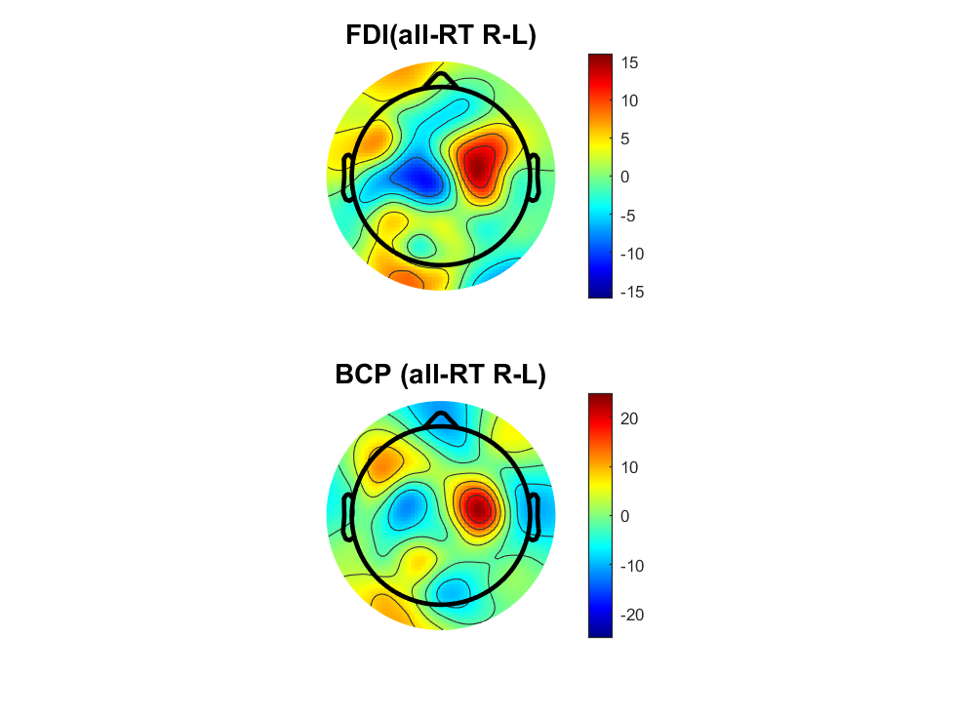

Slide 47
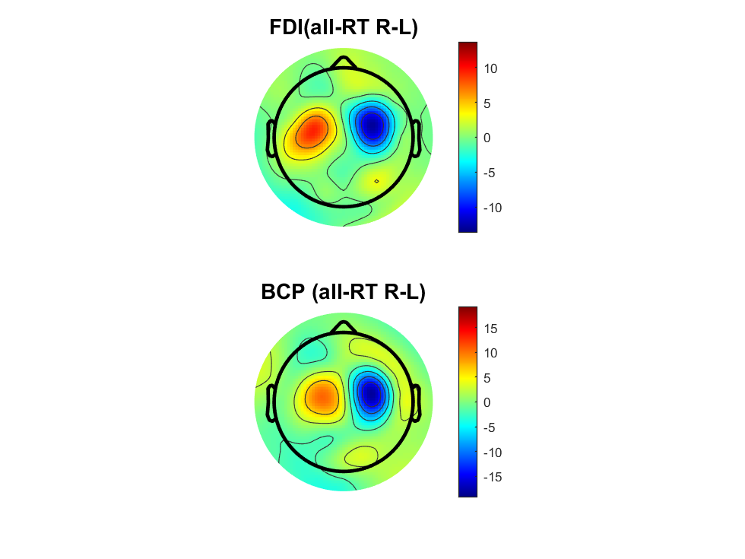
smooth-=10
Notes:
细微位置差异，看终点位置

Slide 48


Slide 49
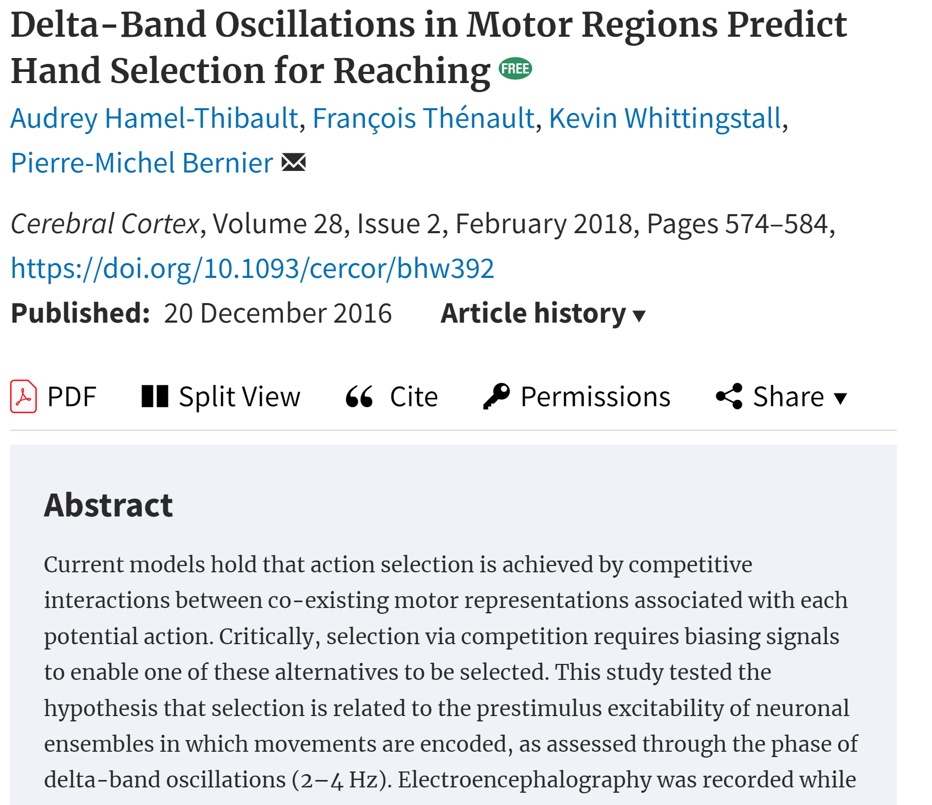
delta-band oscillations (2–4Hz) in motor regions predict hand choice
Hand selection and RT were influenced by the phase of delta oscillations at target onset
brain excitability modulates action selection ,independent of other decision factors.
*(other paper) not symmetric
Notes:
这篇文章研究了运动区域的Delta波段振荡如何预测手部选择。在实验中，参与者需要选择使用左手或右手来快速伸手触及出现的视觉目标。研究人员通过脑电图（EEG）记录了参与者的脑活动，特别关注Delta波（2–4Hz）的振荡相位，发现手部选择以及反应时间与目标出现时刻的Delta波相位强相关，尤其是在对侧的运动区域。这一研究表明，运动区域的神经元兴奋性是手部选择的一个调节因素，独立于传统的决策变量。

Slide 50
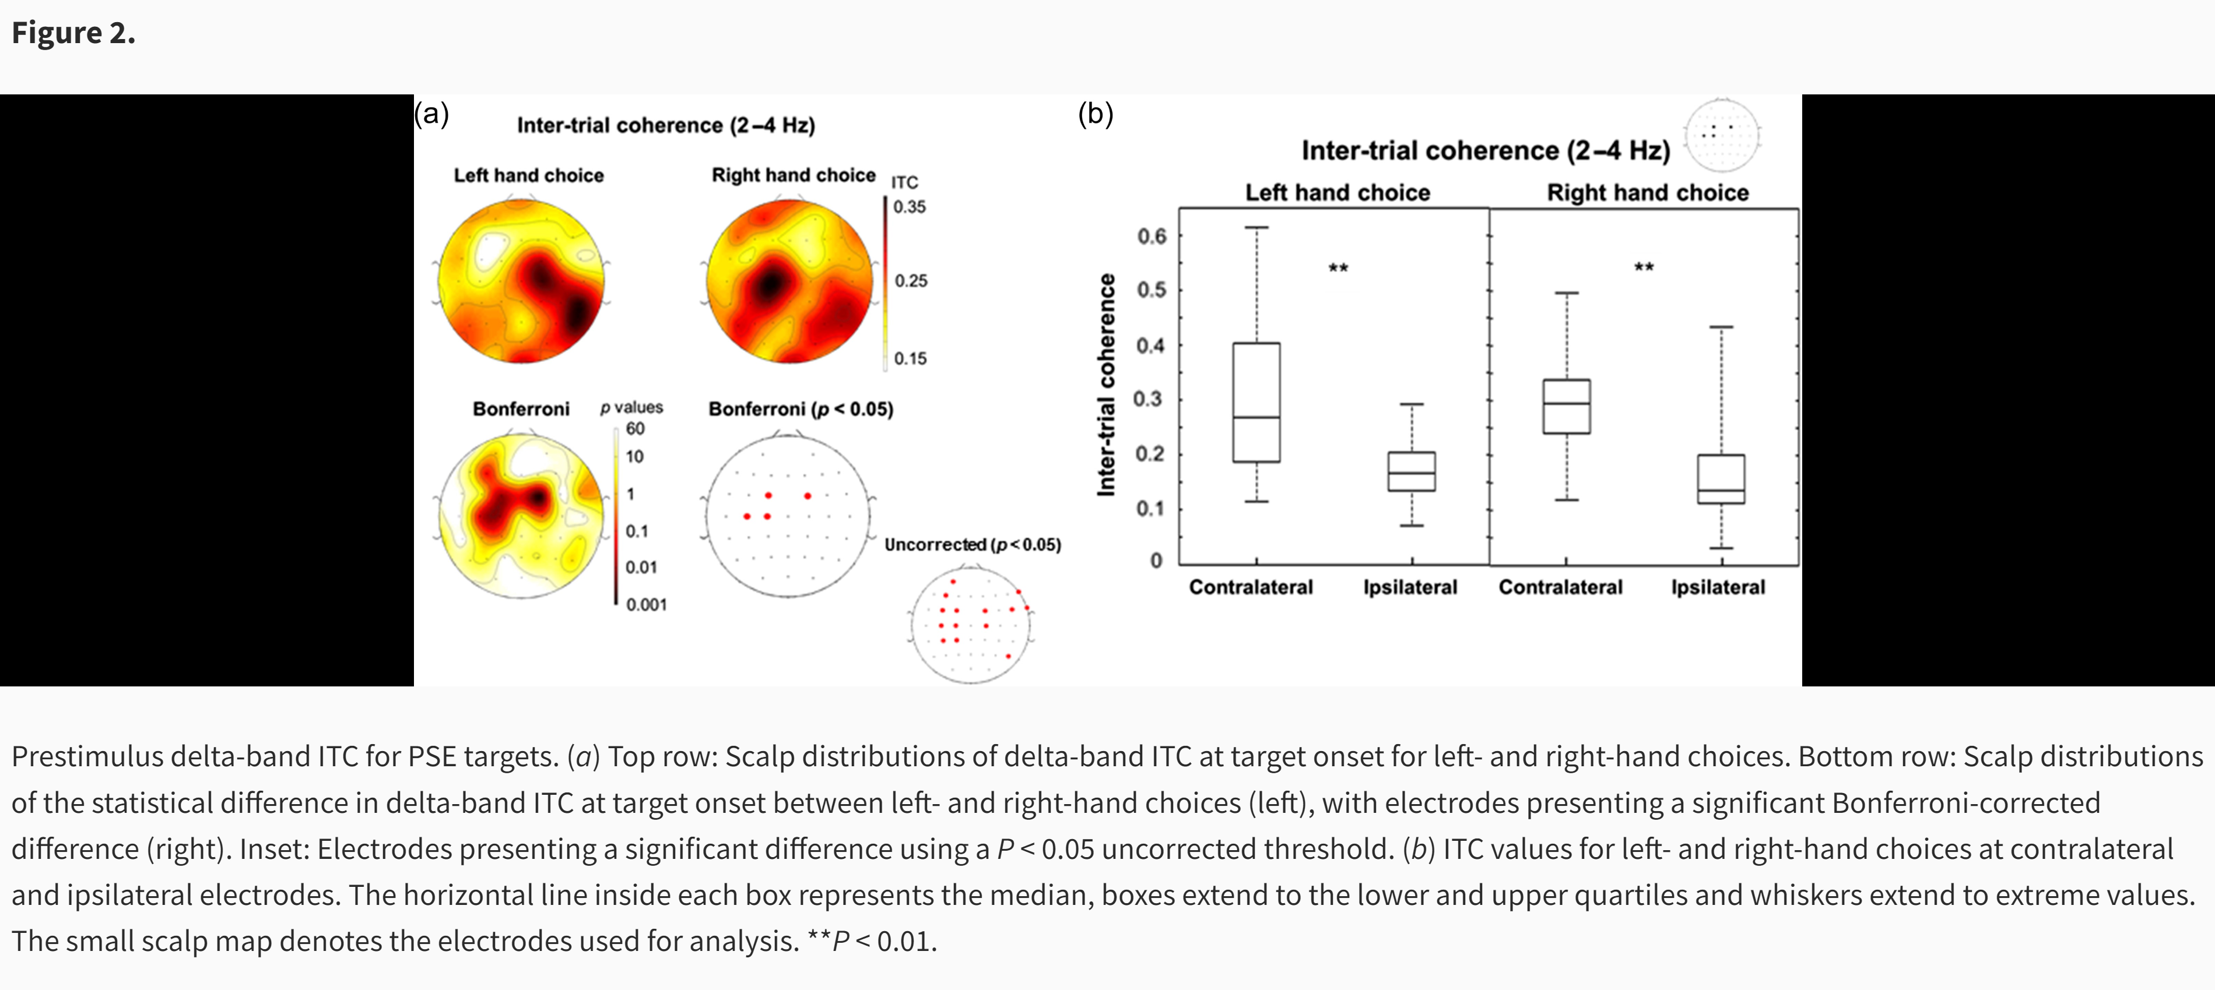
ITC for delta phase
ITC for delta phase

Slide 51
The scalp plot for FDI is clearly wider and BCP narrower (which strongly meet the hypo)
The Contralateral and ipsilateral patten is inversed compared to MuBeta
(C3/C4 plot) It start at same level and have same saturation point
(C3/C4 plot) The slope for the High/ low or FDI/BCP is different, and the diff between Contralateral and ipsilateral is observes after evidence onsite.

Slide 53
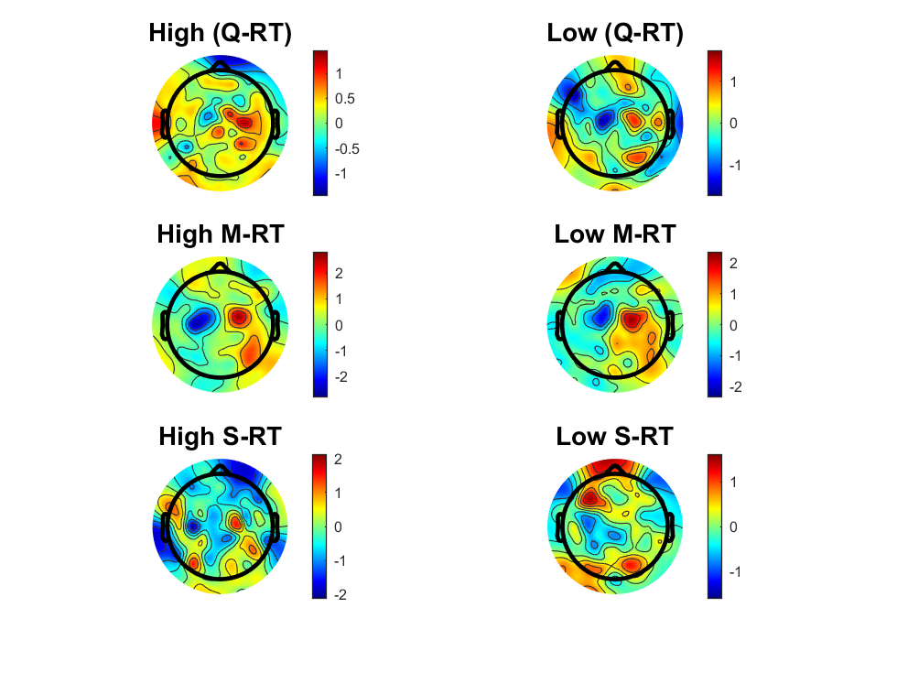
Delta_SL_HL.mat
Notes:
虚线表示样本数量不足，H会缺少慢速应答，且会被走神引起的反应慢扰乱。 L缺少快速应答，且会被预先准备的左右手扰乱。
H: 启动时间相同，到达点位不同
L：启动时间相同，到达点位相同

Slide 54
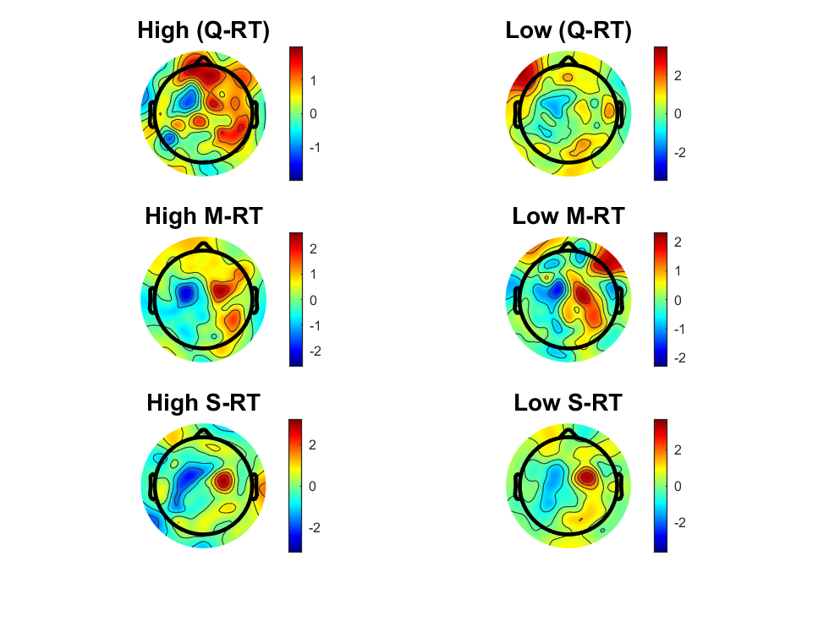
Delta_RL_HL.mat
Notes:
H: 快速斜率更大,启动更靠后
L:

Slide 55
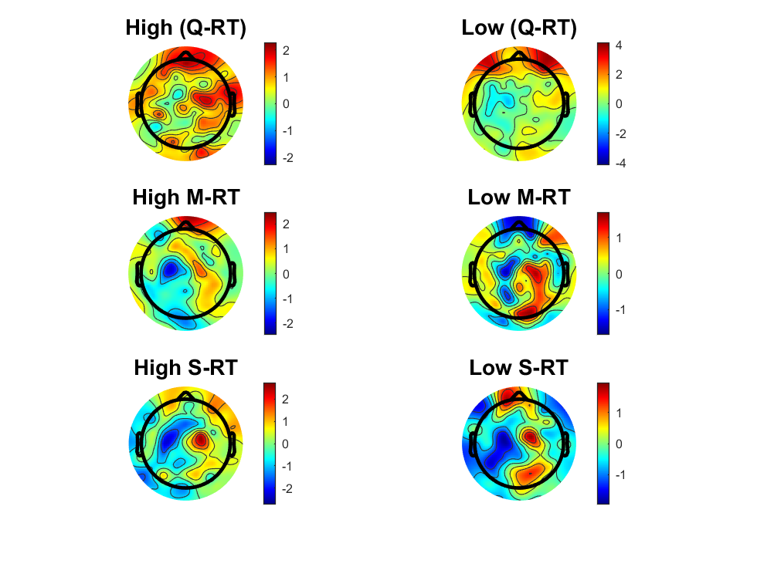
Delta_EOL_HL.mat
Notes:
EOL区别更清晰，规避了MT时间引起的差异（传统应答是用按键）

Slide 57
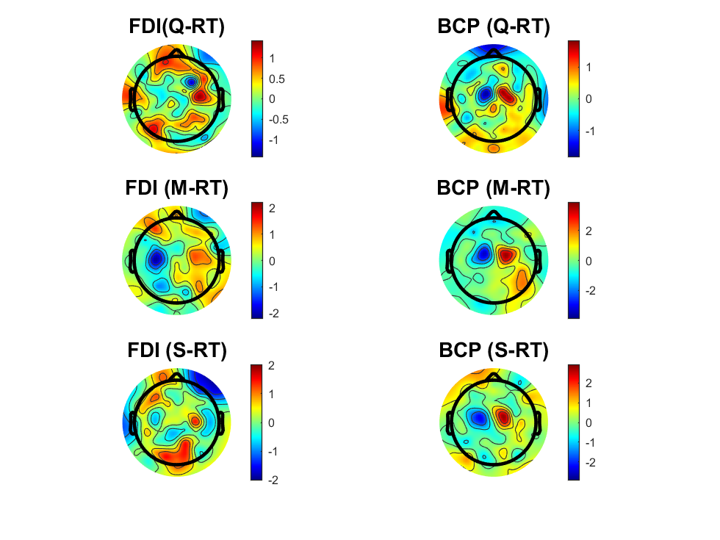
Delta_SL_FDIBCP.mat
Notes:
起始时间点不同，终点时间，幅度不同。 且BCP明显靠里

Slide 58
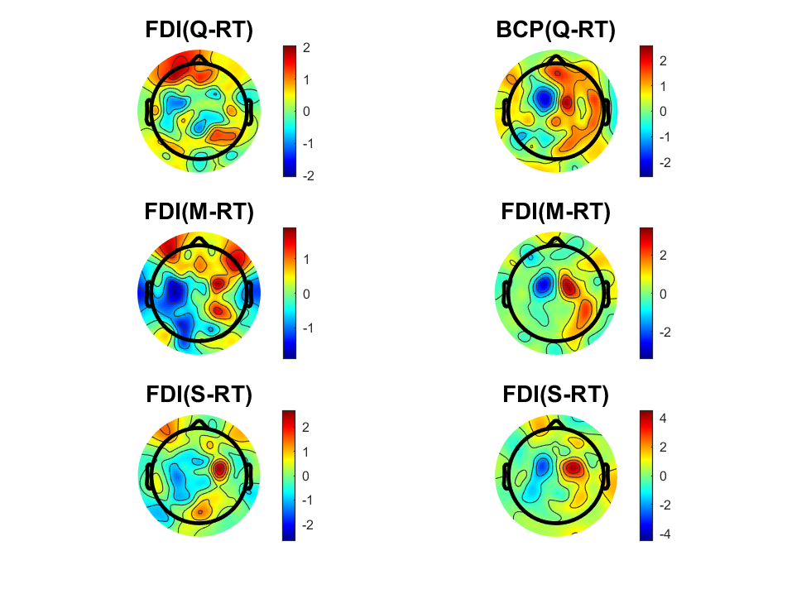
Delta_RL_FDIBCP.mat
Notes:
这是包含MT时间差异的（BCP比FDI反应时间块20ms）
FDI: 三种反应时间结束时间点有先后，且幅度不同。波动性更大（更不稳定-CoM）
BCP： 三种结束时间点/启动时间点相同，且幅度大小相似

Slide 59
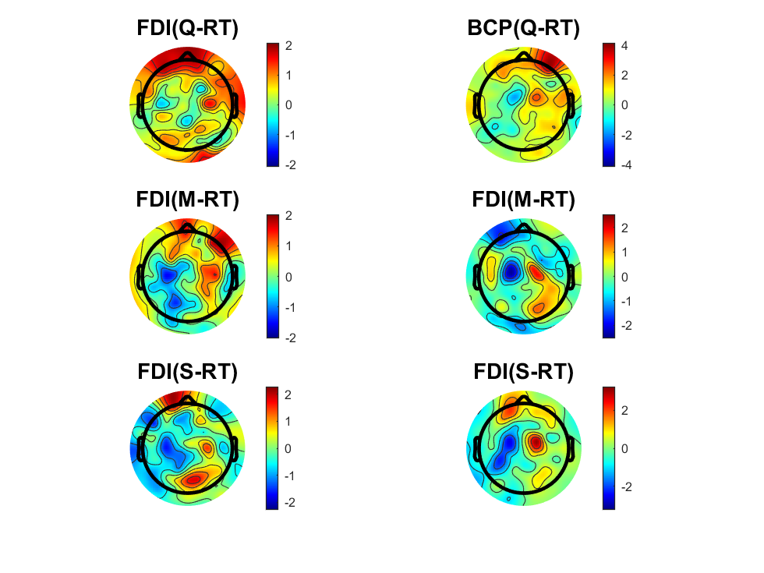
Delta_EOL_FDIBCP.mat
Notes:
这是去除了MT带来的影响，0点位置为PMT结束时的位置（之后的差异是由决策后继续处理信息流（continues flow）以及mT带来的影响）
FDI： 启动时间点不同， PMT后迅速回正，且时间点有先后
BCP： 启动时间点相同，PMT后有滞后性回正，且时间点无先后

Slide 71


Reference
Notes:
Thanks for listening

